Slide 1
GRADE 7 ACCELERATED · UNIT 3
Exponents and Scientific Notation
Ten lessons in teaching order · the next slide jumps to each one
Grade 7 Accelerated · Unit 3 — Exponents and Scientific Notation
1

Slide 2
Contents
Click a lesson to jump to it. Each lesson numbers its slides from 1, as its Teacher Edition does.
3.01
Product Laws of Exponents
slide 3
3.02
Quotient Laws of Exponents
slide 38
3.03
Exponential Expressions
slide 72
3.04
Negative Exponent Law
slide 106
3.05
Applying Exponent Laws
slide 140
3.06–07
Evaluating and Equivalent Expressions
slide 174
T-A1
Exponent Laws with Variable Bases
slide 209
T-A2
Negative Exponents with Variable Bases
slide 243
3.08
Writing Large Numbers in Scientific Notation
slide 277
3.09
Writing Small Numbers in Scientific Notation
slide 311
Grade 7 Accelerated · Unit 3 — Exponents and Scientific Notation
2

Slide 3
GRADE 7 ACCELERATED · UNIT 3 · LESSON 1
Product Laws of Exponents
MA.7.NSO.1.1
I can use the product of powers, power of a product, power of a power and identity laws to rewrite and evaluate a numerical expression.
Last unit you took roots apart.
Today you put powers together — and the base has to match.
Grade 7 Accelerated · Unit 3 · Lesson 1 — Product Laws of Exponents
1

Slide 4
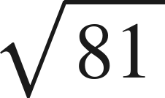
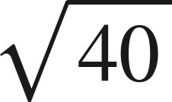

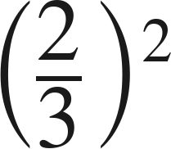
Warm-Up
On your own. Four minutes. No notes.
1.
2. Between which two whole numbers is
?
3. Solve
4. Evaluate
Grade 7 Accelerated · Unit 3 · Lesson 1 — Product Laws of Exponents
2

Slide 5

Warm-Up
Answers.
1.
9
2. Between which two whole numbers is
?
6 and 7
3. Solve
x = 6
4. Evaluate
Grade 7 Accelerated · Unit 3 · Lesson 1 — Product Laws of Exponents
3

Slide 6
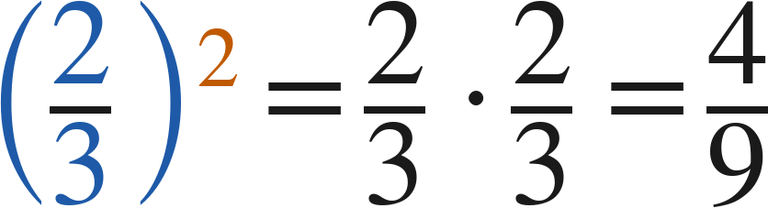
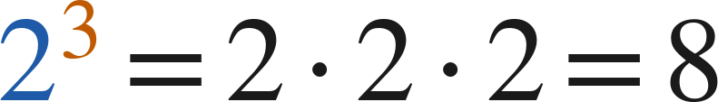
Notes
Copy the three words.
I. A power is a shorthand for repeated multiplication
A.
base — the number used as a factor
B.
exponent — how many times the base is a factor
C.
power — the whole thing, base and exponent together
Grade 7 Accelerated · Unit 3 · Lesson 1 — Product Laws of Exponents
4

Slide 7
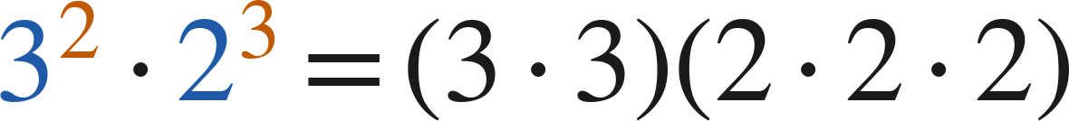

Notes
Where the rule comes from.
II. Product of powers — same base, add the exponents
— different bases, no shortcut
Product of powers:
Check with values:
Grade 7 Accelerated · Unit 3 · Lesson 1 — Product Laws of Exponents
5

Slide 8

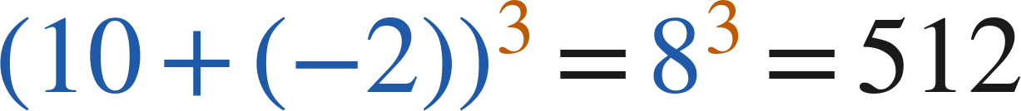

Notes
III. Power of a product — the exponent goes to every factor
Power of a product:
Works for a product only, never for a sum:
but
Grade 7 Accelerated · Unit 3 · Lesson 1 — Product Laws of Exponents
6

Slide 9

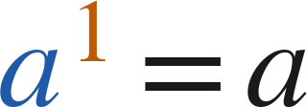
Notes
IV. Power of a power, and the exponent 1
Power of a power | Repeated multiplication | Single power
(4²)³ | 4² · 4² · 4² | 4⁶
(10⁴)⁴ | 10⁴ · 10⁴ · 10⁴ · 10⁴ | 10¹⁶
(3¹)⁵ | 3 · 3 · 3 · 3 · 3 | 3⁵
Power of a power:
Identity:
Grade 7 Accelerated · Unit 3 · Lesson 1 — Product Laws of Exponents
7

Slide 10
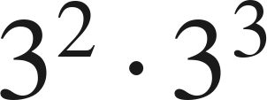
Example 1
Two ways to the same value.
Which law? Then find the value.
Grade 7 Accelerated · Unit 3 · Lesson 1 — Product Laws of Exponents
8

Slide 11



Example 1
Worked both ways.
product of powers: same base, add
evaluate the single power
check: evaluate each, then multiply
Answer: 243
Grade 7 Accelerated · Unit 3 · Lesson 1 — Product Laws of Exponents
9

Slide 12

Your Turn
Same steps, your numbers. Boards up when done.
Grade 7 Accelerated · Unit 3 · Lesson 1 — Product Laws of Exponents
10

Slide 13

Your Turn
Answer.
same base, add: 2⁷
Answer: 2⁷ = 128
Grade 7 Accelerated · Unit 3 · Lesson 1 — Product Laws of Exponents
11

Slide 14
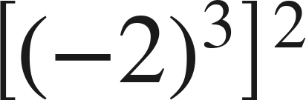
Example 2
A negative base and a power of a power.
Which law? Then find the value.
Grade 7 Accelerated · Unit 3 · Lesson 1 — Product Laws of Exponents
12

Slide 15
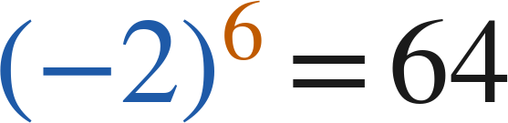

Example 2
Worked.
power of a power: multiply
six negative factors — positive
check: (−2)³ = −8, then square
Answer: 64
Grade 7 Accelerated · Unit 3 · Lesson 1 — Product Laws of Exponents
13

Slide 16
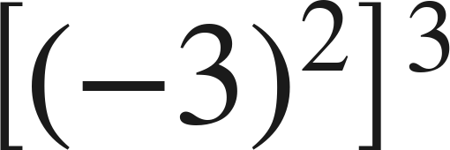
Your Turn
Same steps, your numbers. Boards up when done.
Grade 7 Accelerated · Unit 3 · Lesson 1 — Product Laws of Exponents
14

Slide 17

Your Turn
Answer.
multiply the exponents: (−3)⁶
Answer: (−3)⁶ = 729
Grade 7 Accelerated · Unit 3 · Lesson 1 — Product Laws of Exponents
15

Slide 18
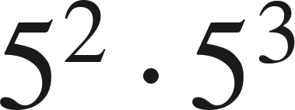
Whiteboards · Question 1 of 9
Boards up on three.
Answer it.
Write it as one power.
Grade 7 Accelerated · Unit 3 · Lesson 1 — Product Laws of Exponents
16

Slide 19


Whiteboards · Question 1 of 9
Answer.
same base, so add the exponents
Answer:
Grade 7 Accelerated · Unit 3 · Lesson 1 — Product Laws of Exponents
17

Slide 20


Whiteboards · Question 2 of 9
Boards up on three.
A tile pattern grows by a factor of
one week,
and by
the next week. It started with 9 tiles.
Write the two-week growth factor as one power, then find its value.
Answer it.
Find the value.
Grade 7 Accelerated · Unit 3 · Lesson 1 — Product Laws of Exponents
18

Slide 21


Whiteboards · Question 2 of 9
Answer.
A tile pattern grows by a factor of
one week,
and by
the next week. It started with 9 tiles.
Write the two-week growth factor as one power, then find its value.
2⁴ · 2² = 2⁶
Answer: 2⁶ = 64
Grade 7 Accelerated · Unit 3 · Lesson 1 — Product Laws of Exponents
19

Slide 22
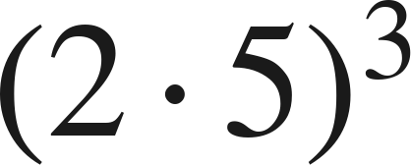
Whiteboards · Question 3 of 9
Boards up on three.
Answer it.
Find the value.
Grade 7 Accelerated · Unit 3 · Lesson 1 — Product Laws of Exponents
20

Slide 23
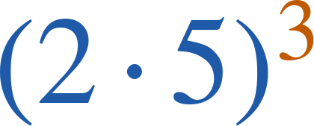
Whiteboards · Question 3 of 9
Answer.
2³ · 5³ = 8 · 125, or 10³
Answer: 1000
Grade 7 Accelerated · Unit 3 · Lesson 1 — Product Laws of Exponents
21

Slide 24
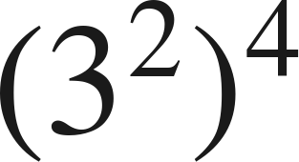
Whiteboards · Question 4 of 9
Boards up on three.
Answer it.
Write it as one power.
Grade 7 Accelerated · Unit 3 · Lesson 1 — Product Laws of Exponents
22

Slide 25
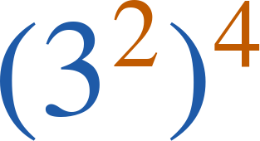

Whiteboards · Question 4 of 9
Answer.
four copies of 3², so eight 3s
Answer:
Grade 7 Accelerated · Unit 3 · Lesson 1 — Product Laws of Exponents
23

Slide 26
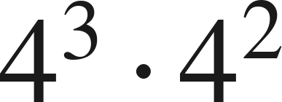
Whiteboards · Question 5 of 9
Boards up on three.
Which expression is equivalent?
A. 4⁵
B. 4⁶
C. 16⁵
D. 8⁵
Answer it.
Grade 7 Accelerated · Unit 3 · Lesson 1 — Product Laws of Exponents
24

Slide 27

Whiteboards · Question 5 of 9
Answer.
Which expression is equivalent?
A. 4⁵
B. 4⁶
C. 16⁵
D. 8⁵
Answer: A — 4⁵
Grade 7 Accelerated · Unit 3 · Lesson 1 — Product Laws of Exponents
25

Slide 28
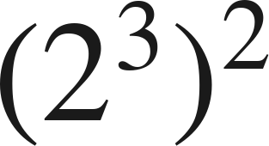
Whiteboards · Question 6 of 9
Boards up on three.
Which expression is equivalent?
A. 2⁶
B. 2⁵
C. 4⁶
D. 2⁹
Answer it.
Grade 7 Accelerated · Unit 3 · Lesson 1 — Product Laws of Exponents
26

Slide 29
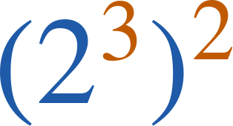
Whiteboards · Question 6 of 9
Answer.
Which expression is equivalent?
A. 2⁶
B. 2⁵
C. 4⁶
D. 2⁹
Answer: A — 2⁶
Grade 7 Accelerated · Unit 3 · Lesson 1 — Product Laws of Exponents
27

Slide 30
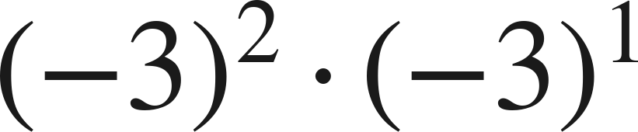
Whiteboards · Question 7 of 9
Boards up on three.
Answer it.
Find the value.
Grade 7 Accelerated · Unit 3 · Lesson 1 — Product Laws of Exponents
28

Slide 31
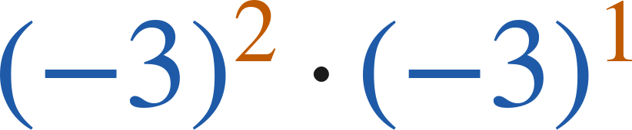
Whiteboards · Question 7 of 9
Answer.
(−3)³ — three negative factors
Answer: −27
Grade 7 Accelerated · Unit 3 · Lesson 1 — Product Laws of Exponents
29

Slide 32
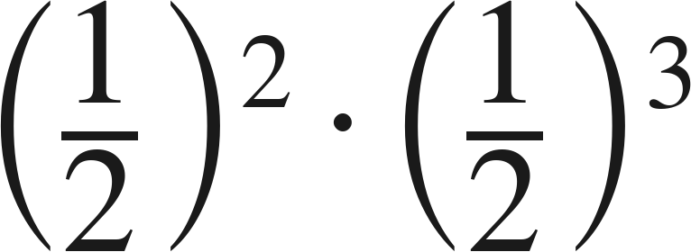
Whiteboards · Question 8 of 9
Boards up on three.
Answer it.
Find the value.
Grade 7 Accelerated · Unit 3 · Lesson 1 — Product Laws of Exponents
30

Slide 33
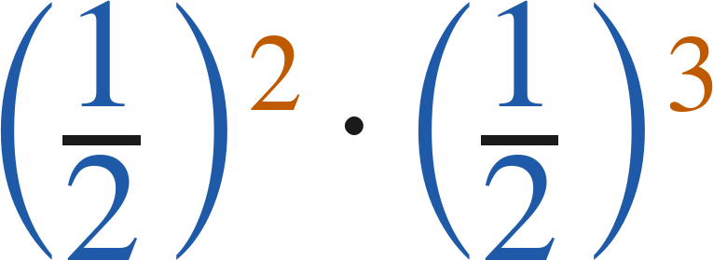

Whiteboards · Question 8 of 9
Answer.
(½)⁵
Answer:
Grade 7 Accelerated · Unit 3 · Lesson 1 — Product Laws of Exponents
31

Slide 34
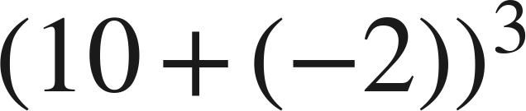
Whiteboards · Question 9 of 9
Take your time. Boards up when you have written it.
Aiyanna says she can use the power of a product law
to evaluate
. Is she right?
Write your answer in sentences.
Say what the law needs, and show the value.
Grade 7 Accelerated · Unit 3 · Lesson 1 — Product Laws of Exponents
32

Slide 35

Whiteboards · Question 9 of 9
Answer.
Aiyanna says she can use the power of a product law
to evaluate
. Is she right?
the parentheses hold a SUM, not a product
Answer: No — (10 + (−2))³ = 8³ = 512
Grade 7 Accelerated · Unit 3 · Lesson 1 — Product Laws of Exponents
33

Slide 36
Independent Set
Six questions. On your own, in silence.
1.
Six questions. Work down the page.
2.
Show the step that does the work, not just the answer.
3.
Silence until the six minutes are up.
Grade 7 Accelerated · Unit 3 · Lesson 1 — Product Laws of Exponents
34

Slide 37
IXL
Last five minutes.
1.
Open IXL and start today's skills.
2.
Work on paper where the question needs work. The answer box does not show it.
3.
Every skill listed is required, to a SmartScore of 67. Due at the start of the next class.
Today's skills — all required
Evaluate powers — SZQ
Multiplication with exponents — 5SK
Power rule — 8DA
Understanding exponents — BFA
Grade 7 Accelerated · Unit 3 · Lesson 1 — Product Laws of Exponents
35

Slide 38
GRADE 7 ACCELERATED · UNIT 3 · LESSON 2
Quotient Laws of Exponents
MA.7.NSO.1.1
I can use the quotient of powers, power of a quotient and zero exponent laws to rewrite and evaluate a numerical expression.
Yesterday: same base, add the exponents.
Today: same base, subtract — and exponent 0 is not 0.
Grade 7 Accelerated · Unit 3 · Lesson 2 — Quotient Laws of Exponents
1

Slide 39



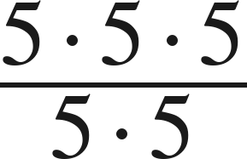
Warm-Up
On your own. Four minutes. No notes.
1. Write as one power:
2.
3. Solve
4. Simplify
Grade 7 Accelerated · Unit 3 · Lesson 2 — Quotient Laws of Exponents
2

Slide 40

Warm-Up
Answers.
1. Write as one power:
2.
−3
3. Solve
x < 4
4. Simplify
5
Grade 7 Accelerated · Unit 3 · Lesson 2 — Quotient Laws of Exponents
3

Slide 41
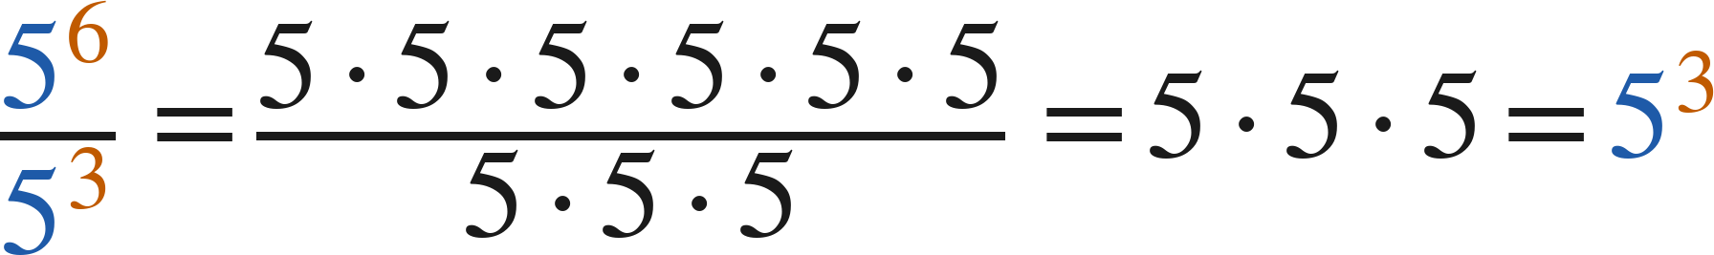
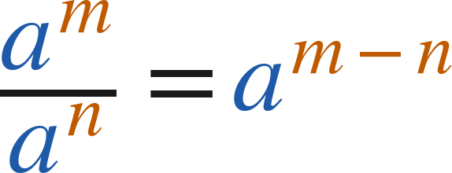

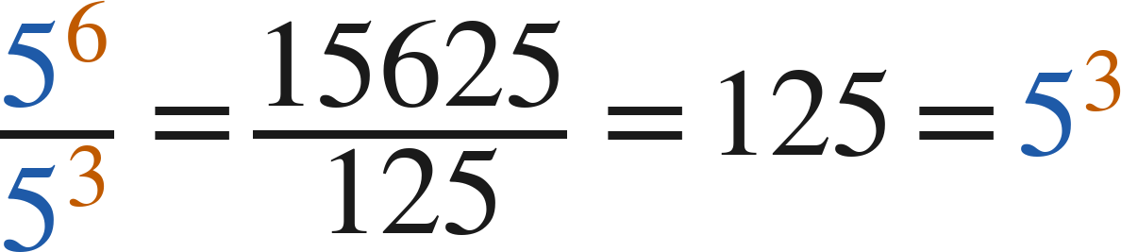
Notes
Where the rule comes from.
I. Quotient of powers — same base, subtract the exponents
Quotient of powers:
(
)
Check with values:
Grade 7 Accelerated · Unit 3 · Lesson 2 — Quotient Laws of Exponents
4

Slide 42
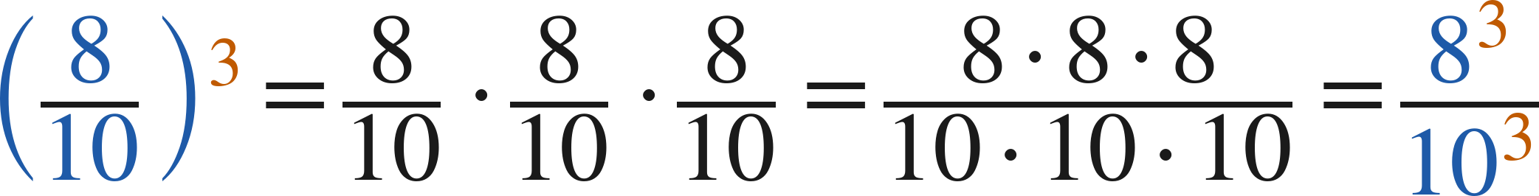
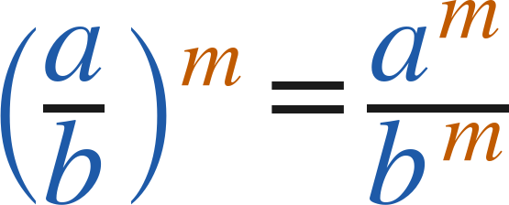
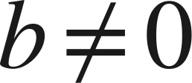
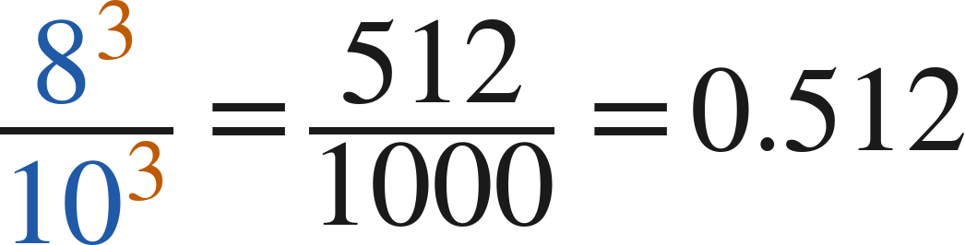

Notes
II. Power of a quotient — the exponent goes top and bottom
Power of a quotient:
(
)
Either way:
and
Grade 7 Accelerated · Unit 3 · Lesson 2 — Quotient Laws of Exponents
5

Slide 43
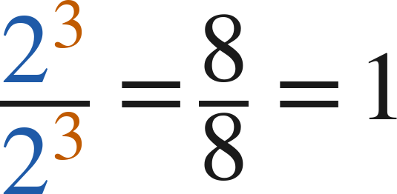
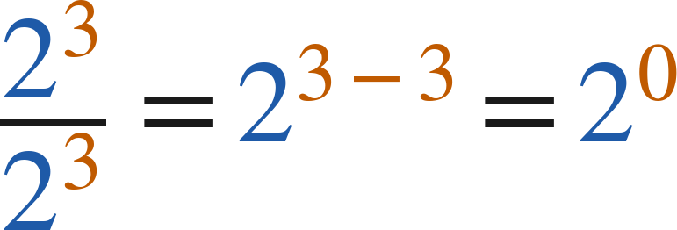
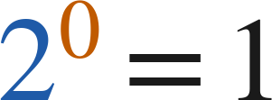
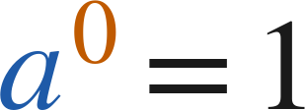

Notes
III. The zero exponent — two roads to the same answer
2⁴ | 2³ | 2² | 2¹ | 2⁰
16 | 8 | 4 | 2 | 1
and
so
Zero exponent:
for every nonzero
Grade 7 Accelerated · Unit 3 · Lesson 2 — Quotient Laws of Exponents
6

Slide 44
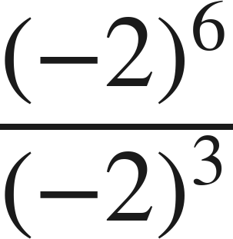
Example 1
A negative base.
Which law? Then find the value.
Grade 7 Accelerated · Unit 3 · Lesson 2 — Quotient Laws of Exponents
7

Slide 45
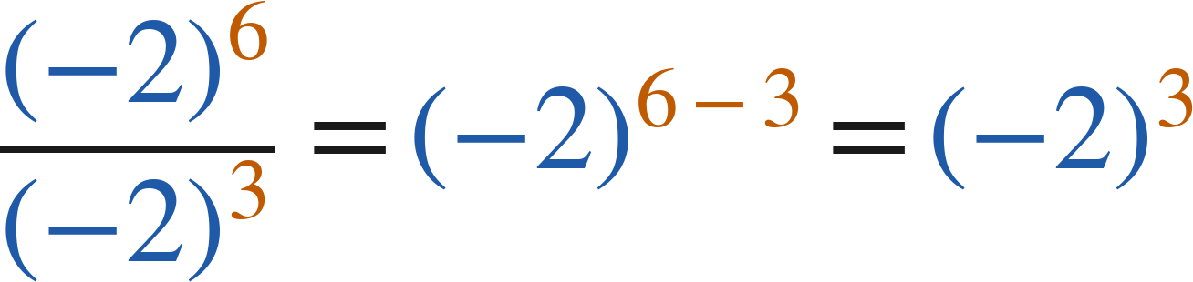
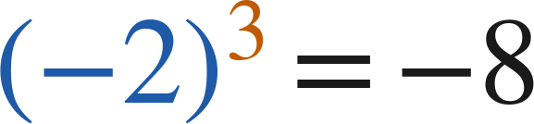
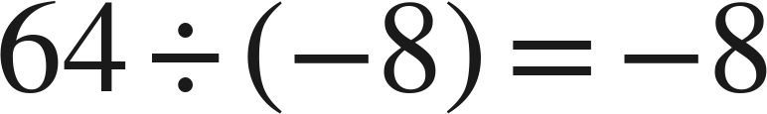
Example 1
Worked.
quotient of powers: subtract
three negative factors
check: evaluate each, then divide
Answer: −8
Grade 7 Accelerated · Unit 3 · Lesson 2 — Quotient Laws of Exponents
8

Slide 46
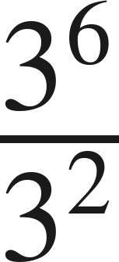
Your Turn
Same steps, your numbers. Boards up when done.
Grade 7 Accelerated · Unit 3 · Lesson 2 — Quotient Laws of Exponents
9

Slide 47

Your Turn
Answer.
same base, subtract: 3⁴
Answer: 3⁴ = 81
Grade 7 Accelerated · Unit 3 · Lesson 2 — Quotient Laws of Exponents
10

Slide 48
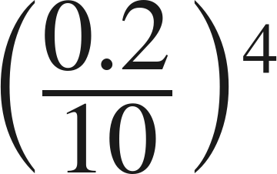
Example 2
A decimal base inside a quotient.
Find the value.
Grade 7 Accelerated · Unit 3 · Lesson 2 — Quotient Laws of Exponents
11

Slide 49
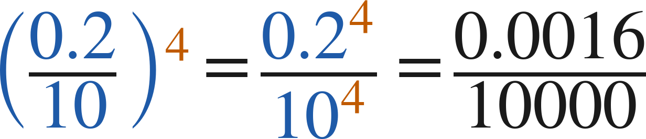
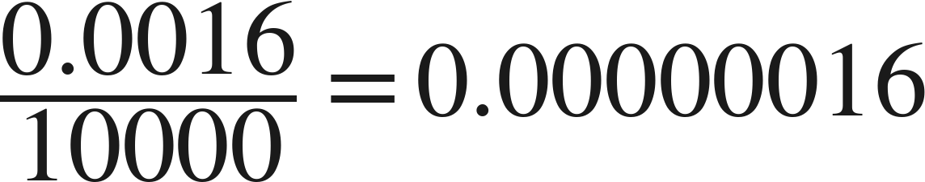
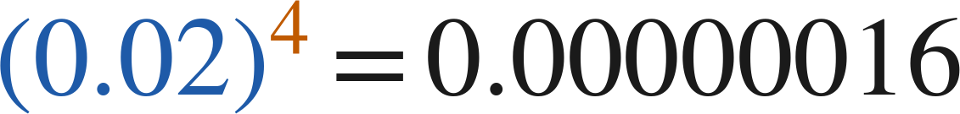
Example 2
Worked both ways.
power of a quotient
divide by 10⁴: four places left
check: divide first, then raise
Answer: 0.00000016
Grade 7 Accelerated · Unit 3 · Lesson 2 — Quotient Laws of Exponents
12

Slide 50
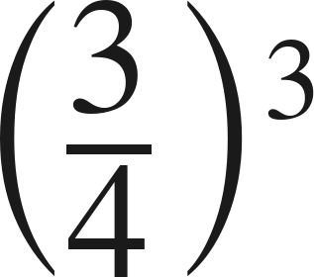
Your Turn
Same steps, your numbers. Boards up when done.
Grade 7 Accelerated · Unit 3 · Lesson 2 — Quotient Laws of Exponents
13

Slide 51
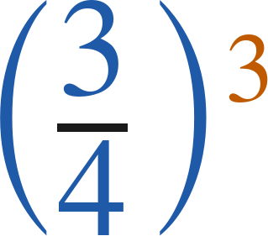

Your Turn
Answer.
numerator and denominator both cubed
Answer:
Grade 7 Accelerated · Unit 3 · Lesson 2 — Quotient Laws of Exponents
14

Slide 52
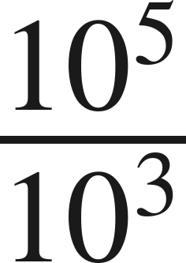
Whiteboards · Question 1 of 9
Boards up on three.
Answer it.
Write it as one power.
Grade 7 Accelerated · Unit 3 · Lesson 2 — Quotient Laws of Exponents
15

Slide 53
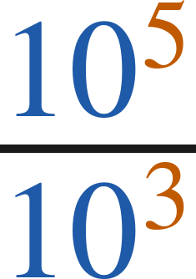

Whiteboards · Question 1 of 9
Answer.
same base, subtract the exponents
Answer:
Grade 7 Accelerated · Unit 3 · Lesson 2 — Quotient Laws of Exponents
16

Slide 54


Whiteboards · Question 2 of 9
Boards up on three.
A server stores
files in
folders, evenly.
It has been running for 30 days.
How many files are in each folder?
Answer it.
Find the value.
Grade 7 Accelerated · Unit 3 · Lesson 2 — Quotient Laws of Exponents
17

Slide 55


Whiteboards · Question 2 of 9
Answer.
A server stores
files in
folders, evenly.
It has been running for 30 days.
How many files are in each folder?
8⁴ ÷ 8¹ = 8³
Answer: 512
Grade 7 Accelerated · Unit 3 · Lesson 2 — Quotient Laws of Exponents
18

Slide 56

Whiteboards · Question 3 of 9
Boards up on three.
Answer it.
Find the value.
Grade 7 Accelerated · Unit 3 · Lesson 2 — Quotient Laws of Exponents
19

Slide 57

Whiteboards · Question 3 of 9
Answer.
(−6)¹
Answer: −6
Grade 7 Accelerated · Unit 3 · Lesson 2 — Quotient Laws of Exponents
20

Slide 58

Whiteboards · Question 4 of 9
Boards up on three.
Answer it.
Apply the power of a quotient law. Do not simplify.
Grade 7 Accelerated · Unit 3 · Lesson 2 — Quotient Laws of Exponents
21

Slide 59


Whiteboards · Question 4 of 9
Answer.
the exponent goes to both
Answer:
Grade 7 Accelerated · Unit 3 · Lesson 2 — Quotient Laws of Exponents
22

Slide 60

Whiteboards · Question 5 of 9
Boards up on three.
Which is the value?
A. 1
B. 0
C. 9
D. 1/9
Answer it.
Grade 7 Accelerated · Unit 3 · Lesson 2 — Quotient Laws of Exponents
23

Slide 61

Whiteboards · Question 5 of 9
Answer.
Which is the value?
A. 1
B. 0
C. 9
D. 1/9
Answer: A — 1
Grade 7 Accelerated · Unit 3 · Lesson 2 — Quotient Laws of Exponents
24

Slide 62

Whiteboards · Question 6 of 9
Boards up on three.
Which expression is equivalent?
A. 4⁶
B. 4⁴
C. 1⁶
D. 4¹⁰
Answer it.
Grade 7 Accelerated · Unit 3 · Lesson 2 — Quotient Laws of Exponents
25

Slide 63

Whiteboards · Question 6 of 9
Answer.
Which expression is equivalent?
A. 4⁶
B. 4⁴
C. 1⁶
D. 4¹⁰
Answer: A — 4⁶
Grade 7 Accelerated · Unit 3 · Lesson 2 — Quotient Laws of Exponents
26

Slide 64

Whiteboards · Question 7 of 9
Boards up on three.
Answer it.
Find the value.
Grade 7 Accelerated · Unit 3 · Lesson 2 — Quotient Laws of Exponents
27

Slide 65

Whiteboards · Question 7 of 9
Answer.
0.5³
Answer: 0.125
Grade 7 Accelerated · Unit 3 · Lesson 2 — Quotient Laws of Exponents
28

Slide 66

Whiteboards · Question 8 of 9
Boards up on three.
Answer it.
Find the value.
Grade 7 Accelerated · Unit 3 · Lesson 2 — Quotient Laws of Exponents
29

Slide 67

Whiteboards · Question 8 of 9
Answer.
any nonzero base to the zero power
Answer: 1
Grade 7 Accelerated · Unit 3 · Lesson 2 — Quotient Laws of Exponents
30

Slide 68


Whiteboards · Question 9 of 9
Take your time. Boards up when you have written it.
Hannah cancels:
. Sebastian subtracts:
.
Who is right?
Write your answer in sentences.
Say what each one did, and what it tells you about 2⁰.
Grade 7 Accelerated · Unit 3 · Lesson 2 — Quotient Laws of Exponents
31

Slide 69

Whiteboards · Question 9 of 9
Answer.
Hannah cancels:
. Sebastian subtracts:
.
Who is right?
both are right, so 2⁰ must equal 1
Answer: Both — 2⁰ = 1
Grade 7 Accelerated · Unit 3 · Lesson 2 — Quotient Laws of Exponents
32

Slide 70
Independent Set
Six questions. On your own, in silence.
1.
Six questions. Work down the page.
2.
Show the step that does the work, not just the answer.
3.
Silence until the six minutes are up.
Grade 7 Accelerated · Unit 3 · Lesson 2 — Quotient Laws of Exponents
33

Slide 71
IXL
Last five minutes.
1.
Open IXL and start today's skills.
2.
Work on paper where the question needs work. The answer box does not show it.
3.
Every skill listed is required, to a SmartScore of 67. Due at the start of the next class.
Today's skills — all required
Powers with negative bases — WFW
Division with exponents — XNC
Identify equivalent expressions involving whole-number exponents — KBE
Grade 7 Accelerated · Unit 3 · Lesson 2 — Quotient Laws of Exponents
34

Slide 72
GRADE 7 ACCELERATED · UNIT 3 · LESSON 3
Exponential Expressions
MA.7.NSO.1.1
I can apply more than one law of exponents to evaluate an expression and to write an equivalent one.
Yesterday: seven laws, one at a time.
Today: two or three laws in one expression — and the order is yours.
Grade 7 Accelerated · Unit 3 · Lesson 3 — Exponential Expressions
1

Slide 73




Warm-Up
On your own. Four minutes. No notes.
1. Find the value:
2. Is
closer to 7 or to 8?
3. Solve
4. Evaluate
Grade 7 Accelerated · Unit 3 · Lesson 3 — Exponential Expressions
2

Slide 74
Warm-Up
Answers.
1. Find the value:
100
2. Is
closer to 7 or to 8?
7
3. Solve
x = 5
4. Evaluate
50
Grade 7 Accelerated · Unit 3 · Lesson 3 — Exponential Expressions
3

Slide 75
Notes
Copy the table. It is your reference for the rest of the unit.
I. The seven laws, in one place
Law | Rule | Example
Product of powers | a^{m} · a^{n} = a^{m+n} | 2³ · 2¹ = 2⁴
Quotient of powers | a^{m} ÷ a^{n} = a^{m-n} | (−3)⁷ ÷ (−3)² = (−3)⁵
Power of a product | (ab)^{m} = a^{m} · b^{m} | (−7 · 3)² = (−7)² · 3²
Power of a quotient | (a ÷ b)^{m} = a^{m} ÷ b^{m} | (13 ÷ 5)³ = 13³ ÷ 5³
Power of a power | (a^{m})^{n} = a^{mn} | (6³)⁴ = 6¹²
Identity exponent | a¹ = a | 15¹ = 15
Zero exponent | a⁰ = 1 | 127⁰ = 1
Grade 7 Accelerated · Unit 3 · Lesson 3 — Exponential Expressions
4

Slide 76


Notes
Two students, two orders, one value.
II. More than one law — make a plan, then follow it
Winston:
Yvette:
Different plans, same value. Any correct sequence of laws gives the same answer.
Grade 7 Accelerated · Unit 3 · Lesson 3 — Exponential Expressions
5

Slide 77


Notes
III. Order of operations still applies
A.
Parentheses first — including a fraction bar, which is a pair of parentheses in disguise.
B.
Exponents next — the laws of exponents are applied here.
C.
Then multiply and divide, left to right; then add and subtract.
D.
Never across a + or a −:
, not
.
Grade 7 Accelerated · Unit 3 · Lesson 3 — Exponential Expressions
6

Slide 78

Example 1
A zero exponent inside a product inside a quotient.
Make a plan. Then find the value.
Grade 7 Accelerated · Unit 3 · Lesson 3 — Exponential Expressions
7

Slide 79



Example 1
Worked — Caroline's plan and Jamir's plan.
Caroline: product of powers first
Jamir: zero exponent first
both: quotient of powers, then evaluate
Answer: 64
Grade 7 Accelerated · Unit 3 · Lesson 3 — Exponential Expressions
8

Slide 80

Your Turn
Same steps, your numbers. Boards up when done.
Grade 7 Accelerated · Unit 3 · Lesson 3 — Exponential Expressions
9

Slide 81

Your Turn
Answer.
5⁴ · 1 over 5², so 5²
Answer: 5² = 25
Grade 7 Accelerated · Unit 3 · Lesson 3 — Exponential Expressions
10

Slide 82

Example 2
Three laws, a decimal and a negative base.
Make a plan. Then find the value.
Grade 7 Accelerated · Unit 3 · Lesson 3 — Exponential Expressions
11

Slide 83



Example 2
Worked.
zero exponent; power of a quotient, backwards
divide inside: −15 ÷ 1.5 = −10
four negative factors: positive
Answer: 10,000
Grade 7 Accelerated · Unit 3 · Lesson 3 — Exponential Expressions
12

Slide 84

Your Turn
Same steps, your numbers. Boards up when done.
Grade 7 Accelerated · Unit 3 · Lesson 3 — Exponential Expressions
13

Slide 85

Your Turn
Answer.
1 · (−12 ÷ 4)³ = (−3)³
Answer: −27
Grade 7 Accelerated · Unit 3 · Lesson 3 — Exponential Expressions
14

Slide 86


Whiteboards · Question 1 of 9
Boards up on three.
A spreadsheet holds
cells in
equal columns.
The file is 3 megabytes.
How many cells are in each column?
Answer it.
Find the value.
Grade 7 Accelerated · Unit 3 · Lesson 3 — Exponential Expressions
15

Slide 87


Whiteboards · Question 1 of 9
Answer.
A spreadsheet holds
cells in
equal columns.
The file is 3 megabytes.
How many cells are in each column?
6⁴ · 1 over 6², so 6²
Answer: 36
Grade 7 Accelerated · Unit 3 · Lesson 3 — Exponential Expressions
16

Slide 88

Whiteboards · Question 2 of 9
Boards up on three.
Answer it.
Find the value.
Grade 7 Accelerated · Unit 3 · Lesson 3 — Exponential Expressions
17

Slide 89

Whiteboards · Question 2 of 9
Answer.
(3²)³ = 3⁶
Answer: 729
Grade 7 Accelerated · Unit 3 · Lesson 3 — Exponential Expressions
18

Slide 90

Whiteboards · Question 3 of 9
Boards up on three.
Answer it.
Find the value.
Grade 7 Accelerated · Unit 3 · Lesson 3 — Exponential Expressions
19

Slide 91

Whiteboards · Question 3 of 9
Answer.
0.5⁶ ÷ 0.5² = 0.5⁴
Answer: 0.0625
Grade 7 Accelerated · Unit 3 · Lesson 3 — Exponential Expressions
20

Slide 92

Whiteboards · Question 4 of 9
Boards up on three.
Answer it.
Find the value.
Grade 7 Accelerated · Unit 3 · Lesson 3 — Exponential Expressions
21

Slide 93

Whiteboards · Question 4 of 9
Answer.
2.5² — the exponent 1 changes nothing
Answer: 6.25
Grade 7 Accelerated · Unit 3 · Lesson 3 — Exponential Expressions
22

Slide 94

Whiteboards · Question 5 of 9
Boards up on three.
Which is the value?
A. 4
B. 2²²
C. 0
D. 1/4
Answer it.
Grade 7 Accelerated · Unit 3 · Lesson 3 — Exponential Expressions
23

Slide 95

Whiteboards · Question 5 of 9
Answer.
Which is the value?
A. 4
B. 2²²
C. 0
D. 1/4
Answer: A — 4
Grade 7 Accelerated · Unit 3 · Lesson 3 — Exponential Expressions
24

Slide 96

Whiteboards · Question 6 of 9
Boards up on three.
Which expression is equivalent?
A. 0.1⁵
B. 0.2⁰ · 0.1²
C. 0.1⁶
D. 0.2³ · 0.1²
Answer it.
Grade 7 Accelerated · Unit 3 · Lesson 3 — Exponential Expressions
25

Slide 97

Whiteboards · Question 6 of 9
Answer.
Which expression is equivalent?
A. 0.1⁵
B. 0.2⁰ · 0.1²
C. 0.1⁶
D. 0.2³ · 0.1²
Answer: A — 0.1⁵
Grade 7 Accelerated · Unit 3 · Lesson 3 — Exponential Expressions
26

Slide 98

Whiteboards · Question 7 of 9
Boards up on three.
Answer it.
Find the value.
Grade 7 Accelerated · Unit 3 · Lesson 3 — Exponential Expressions
27

Slide 99

Whiteboards · Question 7 of 9
Answer.
0.1² · 0.1² = 0.1⁴
Answer: 0.0001
Grade 7 Accelerated · Unit 3 · Lesson 3 — Exponential Expressions
28

Slide 100

Whiteboards · Question 8 of 9
Boards up on three.
Answer it.
Find the value.
Grade 7 Accelerated · Unit 3 · Lesson 3 — Exponential Expressions
29

Slide 101

Whiteboards · Question 8 of 9
Answer.
(−4)³ over 1
Answer: −64
Grade 7 Accelerated · Unit 3 · Lesson 3 — Exponential Expressions
30

Slide 102


Whiteboards · Question 9 of 9
Take your time. Boards up when you have written it.
Winston writes
. Yvette writes
.
Do they get the same value? Explain.
Write your answer in sentences.
Name the law each one used first, and give the value.
Grade 7 Accelerated · Unit 3 · Lesson 3 — Exponential Expressions
31

Slide 103


Whiteboards · Question 9 of 9
Answer.
Winston writes
. Yvette writes
.
Do they get the same value? Explain.
both plans end at 2⁶
Answer: Yes — both give 2⁶ = 64
Grade 7 Accelerated · Unit 3 · Lesson 3 — Exponential Expressions
32

Slide 104
Independent Set
Six questions. On your own, in silence.
1.
Six questions. Work down the page.
2.
Show the step that does the work, not just the answer.
3.
Silence until the six minutes are up.
Grade 7 Accelerated · Unit 3 · Lesson 3 — Exponential Expressions
33

Slide 105
IXL
Last five minutes.
1.
Open IXL and start today's skills.
2.
Work on paper where the question needs work. The answer box does not show it.
3.
Every skill listed is required, to a SmartScore of 67. Due at the start of the next class.
Today's skills — all required
Evaluate expressions using properties of exponents — ZE9
Grade 7 Accelerated · Unit 3 · Lesson 3 — Exponential Expressions
34

Slide 106
GRADE 7 ACCELERATED · UNIT 3 · LESSON 4
Negative Exponent Law
MA.8.NSO.1.3
I can rewrite a power with a negative exponent using a positive exponent, and evaluate it.
Yesterday the exponents stopped at 0.
Today they keep going — and 5⁻² is not a negative number.
Grade 7 Accelerated · Unit 3 · Lesson 4 — Negative Exponent Law
1

Slide 107




Warm-Up
On your own. Four minutes. No notes.
1. Find the value:
2. Which is greater,
or 5.5?
3. Solve
4. What is the reciprocal of
? What is the opposite of
?
Grade 7 Accelerated · Unit 3 · Lesson 4 — Negative Exponent Law
2

Slide 108


Warm-Up
Answers.
1. Find the value:
25
2. Which is greater,
or 5.5?
5.5
3. Solve
x = −7
4. What is the reciprocal of
? What is the opposite of
?
and
Grade 7 Accelerated · Unit 3 · Lesson 4 — Negative Exponent Law
3

Slide 109



Notes
Copy the table.
I. The pattern keeps going past zero
2⁴ | 2³ | 2² | 2¹ | 2⁰ | 2⁻¹ | 2⁻² | 2⁻³
16 | 8 | 4 | 2 | 1 | 1/2 | 1/4 | 1/8
Grade 7 Accelerated · Unit 3 · Lesson 4 — Negative Exponent Law
4

Slide 110






Notes
II. The negative exponent law
(
)
but
and
A negative exponent means reciprocal. It never means a negative value.
The base keeps its own sign:
Grade 7 Accelerated · Unit 3 · Lesson 4 — Negative Exponent Law
5

Slide 111


Notes
III. The laws still work with negative exponents
or
Add, subtract and multiply exponents exactly as before — the exponents are just integers now.
Grade 7 Accelerated · Unit 3 · Lesson 4 — Negative Exponent Law
6

Slide 112

Example 1
Negative exponents top and bottom.
Rewrite with positive exponents, then find the value.
Grade 7 Accelerated · Unit 3 · Lesson 4 — Negative Exponent Law
7

Slide 113


Example 1
Worked.
each power swaps sides and loses the minus
evaluate
Answer: 81/8 = 10.125
Grade 7 Accelerated · Unit 3 · Lesson 4 — Negative Exponent Law
8

Slide 114

Your Turn
Same steps, your numbers. Boards up when done.
Grade 7 Accelerated · Unit 3 · Lesson 4 — Negative Exponent Law
9

Slide 115


Your Turn
Answer.
swap sides, positive exponents: 5¹ over 3²
Answer:
Grade 7 Accelerated · Unit 3 · Lesson 4 — Negative Exponent Law
10

Slide 116

Example 2
A quotient law crossing zero.
Find the value.
Grade 7 Accelerated · Unit 3 · Lesson 4 — Negative Exponent Law
11

Slide 117



Example 2
Worked both ways.
quotient of powers: 0 − (−4) = 4
zero exponent, then move 7⁻⁴ up
evaluate
Answer: 2,401
Grade 7 Accelerated · Unit 3 · Lesson 4 — Negative Exponent Law
12

Slide 118

Your Turn
Same steps, your numbers. Boards up when done.
Grade 7 Accelerated · Unit 3 · Lesson 4 — Negative Exponent Law
13

Slide 119

Your Turn
Answer.
−4 − (−6) = 2, so (−8)²
Answer: 64
Grade 7 Accelerated · Unit 3 · Lesson 4 — Negative Exponent Law
14

Slide 120

Whiteboards · Question 1 of 9
Boards up on three.
Answer it.
Rewrite with a positive exponent.
Grade 7 Accelerated · Unit 3 · Lesson 4 — Negative Exponent Law
15

Slide 121


Whiteboards · Question 1 of 9
Answer.
reciprocal of 8³
Answer:
Grade 7 Accelerated · Unit 3 · Lesson 4 — Negative Exponent Law
16

Slide 122

Whiteboards · Question 2 of 9
Boards up on three.
A pollen grain's mass is
microgram.
Its width is 25 micrometers.
What is the value of
?
Answer it.
Find the value.
Grade 7 Accelerated · Unit 3 · Lesson 4 — Negative Exponent Law
17

Slide 123


Whiteboards · Question 2 of 9
Answer.
A pollen grain's mass is
microgram.
Its width is 25 micrometers.
What is the value of
?
1 over 2⁷
Answer:
Grade 7 Accelerated · Unit 3 · Lesson 4 — Negative Exponent Law
18

Slide 124

Whiteboards · Question 3 of 9
Boards up on three.
Answer it.
Rewrite with a positive exponent, then find the value.
Grade 7 Accelerated · Unit 3 · Lesson 4 — Negative Exponent Law
19

Slide 125

Whiteboards · Question 3 of 9
Answer.
the power moves up: 10²
Answer: 10² = 100
Grade 7 Accelerated · Unit 3 · Lesson 4 — Negative Exponent Law
20

Slide 126

Whiteboards · Question 4 of 9
Boards up on three.
Answer it.
Find the value.
Grade 7 Accelerated · Unit 3 · Lesson 4 — Negative Exponent Law
21

Slide 127


Whiteboards · Question 4 of 9
Answer.
1 over (−2)³ = 1 over −8
Answer:
Grade 7 Accelerated · Unit 3 · Lesson 4 — Negative Exponent Law
22

Slide 128

Whiteboards · Question 5 of 9
Boards up on three.
Which is the value?
A. 1/25
B. −25
C. −10
D. 1/10
Answer it.
Grade 7 Accelerated · Unit 3 · Lesson 4 — Negative Exponent Law
23

Slide 129

Whiteboards · Question 5 of 9
Answer.
Which is the value?
A. 1/25
B. −25
C. −10
D. 1/10
Answer: A — 1/25
Grade 7 Accelerated · Unit 3 · Lesson 4 — Negative Exponent Law
24

Slide 130

Whiteboards · Question 6 of 9
Boards up on three.
Which expression is equivalent?
A. 6³
B. 6⁻⁷
C. 6⁻¹⁰
D. 36³
Answer it.
Grade 7 Accelerated · Unit 3 · Lesson 4 — Negative Exponent Law
25

Slide 131

Whiteboards · Question 6 of 9
Answer.
Which expression is equivalent?
A. 6³
B. 6⁻⁷
C. 6⁻¹⁰
D. 36³
Answer: A — 6³
Grade 7 Accelerated · Unit 3 · Lesson 4 — Negative Exponent Law
26

Slide 132

Whiteboards · Question 7 of 9
Boards up on three.
Answer it.
Find the value.
Grade 7 Accelerated · Unit 3 · Lesson 4 — Negative Exponent Law
27

Slide 133

Whiteboards · Question 7 of 9
Answer.
3⁰
Answer: 1
Grade 7 Accelerated · Unit 3 · Lesson 4 — Negative Exponent Law
28

Slide 134

Whiteboards · Question 8 of 9
Boards up on three.
Answer it.
Write it as one power with a positive exponent.
Grade 7 Accelerated · Unit 3 · Lesson 4 — Negative Exponent Law
29

Slide 135


Whiteboards · Question 8 of 9
Answer.
9⁻⁸
Answer:
Grade 7 Accelerated · Unit 3 · Lesson 4 — Negative Exponent Law
30

Slide 136

Whiteboards · Question 9 of 9
Take your time. Boards up when you have written it.
Ellen says the value of
is −25.
Explain why she is wrong, and show the correct value.
Write your answer in sentences.
Use the word reciprocal.
Grade 7 Accelerated · Unit 3 · Lesson 4 — Negative Exponent Law
31

Slide 137

Whiteboards · Question 9 of 9
Answer.
Ellen says the value of
is −25.
Explain why she is wrong, and show the correct value.
reciprocal, not opposite
Answer: 5⁻² = 1/5² = 1/25
Grade 7 Accelerated · Unit 3 · Lesson 4 — Negative Exponent Law
32

Slide 138
Independent Set
Six questions. On your own, in silence.
1.
Six questions. Work down the page.
2.
Show the step that does the work, not just the answer.
3.
Silence until the six minutes are up.
Grade 7 Accelerated · Unit 3 · Lesson 4 — Negative Exponent Law
33

Slide 139
IXL
Last five minutes.
1.
Open IXL and start today's skills.
2.
Work on paper where the question needs work. The answer box does not show it.
3.
Every skill listed is required, to a SmartScore of 67. Due at the start of the next class.
Today's skills — all required
Understanding negative exponents — YBB
Evaluate powers with negative exponents — WGS
Grade 7 Accelerated · Unit 3 · Lesson 4 — Negative Exponent Law
34

Slide 140
GRADE 7 ACCELERATED · UNIT 3 · LESSON 5
Applying Exponent Laws
MA.8.NSO.1.3
I can rewrite a rational base with a negative exponent using a positive exponent, and apply several laws to generate an equivalent expression.
Yesterday: a negative exponent means reciprocal.
Today the base is a fraction — so the reciprocal flips it.
Grade 7 Accelerated · Unit 3 · Lesson 5 — Applying Exponent Laws
1

Slide 141





Warm-Up
On your own. Four minutes. No notes.
1. Find the value:
2. Rewrite with a positive exponent:
3. Which is larger,
or
?
4. Write the reciprocal of
Grade 7 Accelerated · Unit 3 · Lesson 5 — Applying Exponent Laws
2

Slide 142




Warm-Up
Answers.
1. Find the value:
2. Rewrite with a positive exponent:
3. Which is larger,
or
?
(81 > 64)
4. Write the reciprocal of
Grade 7 Accelerated · Unit 3 · Lesson 5 — Applying Exponent Laws
3

Slide 143
Notes
Copy the table.
I. The pattern with a fraction base
Expression | Expanded | Value
(2/5)² | 2/5 · 2/5 | 4/25
(2/5)¹ | 2/5 | 2/5
(2/5)⁰ | 1 | 1
(2/5)⁻¹ | 5/2 | 5/2
(2/5)⁻² | 5/2 · 5/2 | 25/4
Grade 7 Accelerated · Unit 3 · Lesson 5 — Applying Exponent Laws
4

Slide 144





Notes
II. Flip the base, make the exponent positive
(
)
The sign stays with the fraction. Flip the numbers, not the sign.
A whole number is a fraction over 1:
Grade 7 Accelerated · Unit 3 · Lesson 5 — Applying Exponent Laws
5

Slide 145

Notes
III. Several laws at once — the plan is still yours
Any correct order of laws gives the same value. Finish with a positive exponent.
Grade 7 Accelerated · Unit 3 · Lesson 5 — Applying Exponent Laws
6

Slide 146

Example 1
Flip, then evaluate.
Rewrite with a positive exponent, then find the value.
Grade 7 Accelerated · Unit 3 · Lesson 5 — Applying Exponent Laws
7

Slide 147


Example 1
Worked.
flip the base; the sign stays
even power: positive
Answer: 64/49
Grade 7 Accelerated · Unit 3 · Lesson 5 — Applying Exponent Laws
8

Slide 148

Your Turn
Same steps, your numbers. Boards up when done.
Grade 7 Accelerated · Unit 3 · Lesson 5 — Applying Exponent Laws
9

Slide 149


Your Turn
Answer.
(−2/5)³ — odd power, negative
Answer:
Grade 7 Accelerated · Unit 3 · Lesson 5 — Applying Exponent Laws
10

Slide 150

Example 2
Two laws, then a flip.
Write an equivalent expression with one base and a positive exponent.
Grade 7 Accelerated · Unit 3 · Lesson 5 — Applying Exponent Laws
11

Slide 151


Example 2
Worked.
product of powers
already positive: no flip
Answer: (5/8)² = 25/64
Grade 7 Accelerated · Unit 3 · Lesson 5 — Applying Exponent Laws
12

Slide 152

Your Turn
Same steps, your numbers. Boards up when done.
Grade 7 Accelerated · Unit 3 · Lesson 5 — Applying Exponent Laws
13

Slide 153


Your Turn
Answer.
exponent −10, then flip: (−4/5)¹⁰
Answer:
Grade 7 Accelerated · Unit 3 · Lesson 5 — Applying Exponent Laws
14

Slide 154

Whiteboards · Question 1 of 9
Boards up on three.
A recipe is scaled by a factor of
.
The original recipe serves 6 people.
Rewrite the factor with a positive exponent.
Answer it.
Rewrite with a positive exponent.
Grade 7 Accelerated · Unit 3 · Lesson 5 — Applying Exponent Laws
15

Slide 155


Whiteboards · Question 1 of 9
Answer.
A recipe is scaled by a factor of
.
The original recipe serves 6 people.
Rewrite the factor with a positive exponent.
flip the base
Answer:
Grade 7 Accelerated · Unit 3 · Lesson 5 — Applying Exponent Laws
16

Slide 156

Whiteboards · Question 2 of 9
Boards up on three.
Answer it.
Rewrite with a positive exponent.
Grade 7 Accelerated · Unit 3 · Lesson 5 — Applying Exponent Laws
17

Slide 157


Whiteboards · Question 2 of 9
Answer.
flip the numbers; the sign stays in the fraction
Answer:
Grade 7 Accelerated · Unit 3 · Lesson 5 — Applying Exponent Laws
18

Slide 158

Whiteboards · Question 3 of 9
Boards up on three.
Answer it.
Find the value.
Grade 7 Accelerated · Unit 3 · Lesson 5 — Applying Exponent Laws
19

Slide 159


Whiteboards · Question 3 of 9
Answer.
(−9/8)² = 81/64
Answer:
Grade 7 Accelerated · Unit 3 · Lesson 5 — Applying Exponent Laws
20

Slide 160

Whiteboards · Question 4 of 9
Boards up on three.
Answer it.
Rewrite with a positive exponent.
Grade 7 Accelerated · Unit 3 · Lesson 5 — Applying Exponent Laws
21

Slide 161


Whiteboards · Question 4 of 9
Answer.
flip
Answer:
Grade 7 Accelerated · Unit 3 · Lesson 5 — Applying Exponent Laws
22

Slide 162

Whiteboards · Question 5 of 9
Boards up on three.
Which expression is equivalent?
A. (−8/7)³
B. (8/7)³
C. (−7/8)³
D. (7/8)³
Answer it.
Grade 7 Accelerated · Unit 3 · Lesson 5 — Applying Exponent Laws
23

Slide 163

Whiteboards · Question 5 of 9
Answer.
Which expression is equivalent?
A. (−8/7)³
B. (8/7)³
C. (−7/8)³
D. (7/8)³
Answer: A — (−8/7)³
Grade 7 Accelerated · Unit 3 · Lesson 5 — Applying Exponent Laws
24

Slide 164

Whiteboards · Question 6 of 9
Boards up on three.
Which expression is equivalent?
A. (5/8)²
B. (8/5)²
C. (5/8)⁻⁶
D. (5/8)⁸
Answer it.
Grade 7 Accelerated · Unit 3 · Lesson 5 — Applying Exponent Laws
25

Slide 165

Whiteboards · Question 6 of 9
Answer.
Which expression is equivalent?
A. (5/8)²
B. (8/5)²
C. (5/8)⁻⁶
D. (5/8)⁸
Answer: A — (5/8)²
Grade 7 Accelerated · Unit 3 · Lesson 5 — Applying Exponent Laws
26

Slide 166

Whiteboards · Question 7 of 9
Boards up on three.
Answer it.
Find the value.
Grade 7 Accelerated · Unit 3 · Lesson 5 — Applying Exponent Laws
27

Slide 167


Whiteboards · Question 7 of 9
Answer.
(5/2)¹ · (5/2)¹ = (5/2)²
Answer:
Grade 7 Accelerated · Unit 3 · Lesson 5 — Applying Exponent Laws
28

Slide 168

Whiteboards · Question 8 of 9
Boards up on three.
Answer it.
Write it with one base and one positive exponent.
Grade 7 Accelerated · Unit 3 · Lesson 5 — Applying Exponent Laws
29

Slide 169


Whiteboards · Question 8 of 9
Answer.
(2/3)³ inside, then power of a power
Answer:
Grade 7 Accelerated · Unit 3 · Lesson 5 — Applying Exponent Laws
30

Slide 170


Whiteboards · Question 9 of 9
Take your time. Boards up when you have written it.
Marco says
can be rewritten as
because 'two negatives make a positive.' Is he right?
Write your answer in sentences.
Say what the negative exponent does, and what it does not do. Give the correct rewrite.
Grade 7 Accelerated · Unit 3 · Lesson 5 — Applying Exponent Laws
31

Slide 171


Whiteboards · Question 9 of 9
Answer.
Marco says
can be rewritten as
because 'two negatives make a positive.' Is he right?
the exponent flips the fraction; it never touches the sign
Answer: No — (−2/3)⁻⁵ = (−3/2)⁵
Grade 7 Accelerated · Unit 3 · Lesson 5 — Applying Exponent Laws
32

Slide 172
Independent Set
Six questions. On your own, in silence.
1.
Six questions. Work down the page.
2.
Show the step that does the work, not just the answer.
3.
Silence until the six minutes are up.
Grade 7 Accelerated · Unit 3 · Lesson 5 — Applying Exponent Laws
33

Slide 173
IXL
Last five minutes.
1.
Open IXL and start today's skills.
2.
Work on paper where the question needs work. The answer box does not show it.
3.
Every skill listed is required, to a SmartScore of 67. Due at the start of the next class.
Today's skills — all required
Identify equivalent expressions involving exponents I — VLM
Grade 7 Accelerated · Unit 3 · Lesson 5 — Applying Exponent Laws
34

Slide 174
GRADE 7 ACCELERATED · UNIT 3 · LESSONS 6–7
Evaluating and Equivalent Expressions
MA.8.NSO.1.3
I can evaluate an expression with integer exponents using the laws, and decide whether two expressions with different bases are equivalent.
So far: every law, every kind of base, every kind of exponent.
Today: use all of it at once — and rewrite bases to compare.
Grade 7 Accelerated · Unit 3 · Lessons 6–7 — Evaluating and Equivalent Expressions
1

Slide 175



Warm-Up
On your own. Four minutes. No notes.
1. Rewrite with a positive exponent, then evaluate:
2. Find the value:
3. Find the value:
4. Write 64 as a power of 2, of 4, and of 8.
Grade 7 Accelerated · Unit 3 · Lessons 6–7 — Evaluating and Equivalent Expressions
2

Slide 176




Warm-Up
Answers.
1. Rewrite with a positive exponent, then evaluate:
2. Find the value:
25
3. Find the value:
100
4. Write 64 as a power of 2, of 4, and of 8.
,
,
Grade 7 Accelerated · Unit 3 · Lessons 6–7 — Evaluating and Equivalent Expressions
3

Slide 177


Notes
I. Two students, two plans, one value
Melanie:
Adonis:
Apply the laws first, evaluate last. The value is the same; the arithmetic is smaller.
Grade 7 Accelerated · Unit 3 · Lessons 6–7 — Evaluating and Equivalent Expressions
4

Slide 178





Notes
Copy the worked line.
II. Every law, one expression
Find the step that broke:
— wrong: multiplied; should be
— wrong: flipped, kept the minus; should be
Grade 7 Accelerated · Unit 3 · Lessons 6–7 — Evaluating and Equivalent Expressions
5

Slide 179


Notes
III. Different bases, same value — rewrite to a common base
Base | Square | Cube | Fourth
2 | 2² = 4 | 2³ = 8 | 2⁴ = 16
3 | 3² = 9 | 3³ = 27 | 3⁴ = 81
5 | 5² = 25 | 5³ = 125 | 5⁴ = 625
Grade 7 Accelerated · Unit 3 · Lessons 6–7 — Evaluating and Equivalent Expressions
6

Slide 180



Notes
IV. Testing equivalence: Xavier's claim
Same base, then compare exponents.
— so Xavier is wrong.
Grade 7 Accelerated · Unit 3 · Lessons 6–7 — Evaluating and Equivalent Expressions
7

Slide 181

Example 1
Evaluate.
Find the value.
Grade 7 Accelerated · Unit 3 · Lessons 6–7 — Evaluating and Equivalent Expressions
8

Slide 182


Example 1
Worked.
negative exponent: flip
power of a quotient, then multiply
Answer: 16/3
Grade 7 Accelerated · Unit 3 · Lessons 6–7 — Evaluating and Equivalent Expressions
9

Slide 183

Your Turn
Same steps, your numbers. Boards up when done.
Grade 7 Accelerated · Unit 3 · Lessons 6–7 — Evaluating and Equivalent Expressions
10

Slide 184


Your Turn
Answer.
(5/2)² · 2 = 25/4 · 2
Answer:
Grade 7 Accelerated · Unit 3 · Lessons 6–7 — Evaluating and Equivalent Expressions
11

Slide 185


Example 2
Equivalent or not?
Are
and
equivalent?
Rewrite both with the bases 3 and 2, then compare.
Grade 7 Accelerated · Unit 3 · Lessons 6–7 — Evaluating and Equivalent Expressions
12

Slide 186


Example 2
Worked.
power of a product, product of powers
power of a product, quotient of powers
same bases, same exponents
Answer: Yes — both are 3⁵ · 2³ = 1944
Grade 7 Accelerated · Unit 3 · Lessons 6–7 — Evaluating and Equivalent Expressions
13

Slide 187


Your Turn
Same steps, your numbers. Boards up when done.
Are
and
equivalent?
Grade 7 Accelerated · Unit 3 · Lessons 6–7 — Evaluating and Equivalent Expressions
14

Slide 188


Your Turn
Answer.
Are
and
equivalent?
both are 2⁵ · 5³
Answer: Yes — 2⁵ · 5³ = 4000
Grade 7 Accelerated · Unit 3 · Lessons 6–7 — Evaluating and Equivalent Expressions
15

Slide 189

Whiteboards · Question 1 of 9
Boards up on three.
Answer it.
Find the value.
Grade 7 Accelerated · Unit 3 · Lessons 6–7 — Evaluating and Equivalent Expressions
16

Slide 190

Whiteboards · Question 1 of 9
Answer.
(−7)⁵ over (−7)², so (−7)³
Answer: −343
Grade 7 Accelerated · Unit 3 · Lessons 6–7 — Evaluating and Equivalent Expressions
17

Slide 191

Whiteboards · Question 2 of 9
Boards up on three.
Answer it.
Find the value.
Grade 7 Accelerated · Unit 3 · Lessons 6–7 — Evaluating and Equivalent Expressions
18

Slide 192


Whiteboards · Question 2 of 9
Answer.
−3 − (−2) = −1, so (3/4)⁻¹
Answer:
Grade 7 Accelerated · Unit 3 · Lessons 6–7 — Evaluating and Equivalent Expressions
19

Slide 193

Whiteboards · Question 3 of 9
Boards up on three.
Answer it.
Find the value.
Grade 7 Accelerated · Unit 3 · Lessons 6–7 — Evaluating and Equivalent Expressions
20

Slide 194


Whiteboards · Question 3 of 9
Answer.
2⁻³ · 2⁴ over 2³ = 2⁻²
Answer:
Grade 7 Accelerated · Unit 3 · Lessons 6–7 — Evaluating and Equivalent Expressions
21

Slide 195

Whiteboards · Question 4 of 9
Boards up on three.
A drive holds
megabytes.
It costs 45 dollars.
Write
as a power of 2.
Answer it.
Write it as a power of 2.
Grade 7 Accelerated · Unit 3 · Lessons 6–7 — Evaluating and Equivalent Expressions
22

Slide 196


Whiteboards · Question 4 of 9
Answer.
A drive holds
megabytes.
It costs 45 dollars.
Write
as a power of 2.
8 = 2³, so (2³)⁵
Answer:
Grade 7 Accelerated · Unit 3 · Lessons 6–7 — Evaluating and Equivalent Expressions
23

Slide 197

Whiteboards · Question 5 of 9
Boards up on three.
Which expression is equivalent?
A. 3⁸
B. 3⁶
C. 3⁴
D. 3¹⁶
Answer it.
Grade 7 Accelerated · Unit 3 · Lessons 6–7 — Evaluating and Equivalent Expressions
24

Slide 198

Whiteboards · Question 5 of 9
Answer.
Which expression is equivalent?
A. 3⁸
B. 3⁶
C. 3⁴
D. 3¹⁶
Answer: A — 3⁸
Grade 7 Accelerated · Unit 3 · Lessons 6–7 — Evaluating and Equivalent Expressions
25

Slide 199

Whiteboards · Question 6 of 9
Boards up on three.
Which expression is equivalent?
A. 2⁻⁷
B. 2⁻⁵
C. 2⁷
D. 2⁻¹²
Answer it.
Grade 7 Accelerated · Unit 3 · Lessons 6–7 — Evaluating and Equivalent Expressions
26

Slide 200

Whiteboards · Question 6 of 9
Answer.
Which expression is equivalent?
A. 2⁻⁷
B. 2⁻⁵
C. 2⁷
D. 2⁻¹²
Answer: A — 2⁻⁷
Grade 7 Accelerated · Unit 3 · Lessons 6–7 — Evaluating and Equivalent Expressions
27

Slide 201

Whiteboards · Question 7 of 9
Boards up on three.
Answer it.
Write it as one power of 2.
Grade 7 Accelerated · Unit 3 · Lessons 6–7 — Evaluating and Equivalent Expressions
28

Slide 202


Whiteboards · Question 7 of 9
Answer.
4³ = (2²)³ = 2⁶
Answer:
Grade 7 Accelerated · Unit 3 · Lessons 6–7 — Evaluating and Equivalent Expressions
29

Slide 203

Whiteboards · Question 8 of 9
Boards up on three.
Answer it.
Write it as one power of 2.
Grade 7 Accelerated · Unit 3 · Lessons 6–7 — Evaluating and Equivalent Expressions
30

Slide 204


Whiteboards · Question 8 of 9
Answer.
4⁵ = (2²)⁵
Answer:
Grade 7 Accelerated · Unit 3 · Lessons 6–7 — Evaluating and Equivalent Expressions
31

Slide 205


Whiteboards · Question 9 of 9
Take your time. Boards up when you have written it.
Xavier says
and
are equivalent
because both can be written as
. Do you agree?
Write your answer in sentences.
Rewrite each with base 2, and say what you find.
Grade 7 Accelerated · Unit 3 · Lessons 6–7 — Evaluating and Equivalent Expressions
32

Slide 206


Whiteboards · Question 9 of 9
Answer.
Xavier says
and
are equivalent
because both can be written as
. Do you agree?
2⁻⁷ and 2⁻⁶
Answer: No — the second is 2⁻⁶, not 2⁻⁷
Grade 7 Accelerated · Unit 3 · Lessons 6–7 — Evaluating and Equivalent Expressions
33

Slide 207
Independent Set
Six questions. On your own, in silence.
1.
Six questions. Work down the page.
2.
Show the step that does the work, not just the answer.
3.
Silence until the six minutes are up.
Grade 7 Accelerated · Unit 3 · Lessons 6–7 — Evaluating and Equivalent Expressions
34

Slide 208
IXL
Last five minutes.
1.
Open IXL and start today's skills.
2.
Work on paper where the question needs work. The answer box does not show it.
3.
Every skill listed is required, to a SmartScore of 67. Due at the start of the next class.
Today's skills — all required
Evaluate expressions using properties of exponents — 6T7
Identify equivalent expressions involving exponents II — QDM
Grade 7 Accelerated · Unit 3 · Lessons 6–7 — Evaluating and Equivalent Expressions
35

Slide 209
GRADE 7 ACCELERATED · UNIT 3 · THREAD A · DAY 1
Exponent Laws with Variable Bases
MA.8.AR.1.1
I can multiply and divide monomials, and raise a monomial to a power, by applying the laws of exponents to variable bases.
Yesterday the bases were all numbers.
Today the base is a letter. Every law still works.
Grade 7 Accelerated · Unit 3 · Thread A · Day 1 — Exponent Laws with Variable Bases
1

Slide 210



Warm-Up
On your own. Four minutes. No notes.
1. Find the value:
2. Write as one power:
3.
is between which two whole numbers?
4. Write with an exponent:
Grade 7 Accelerated · Unit 3 · Thread A · Day 1 — Exponent Laws with Variable Bases
2

Slide 211

Warm-Up
Answers.
1. Find the value:
4
2. Write as one power:
6² = 36
3.
is between which two whole numbers?
7 and 8
4. Write with an exponent:
Grade 7 Accelerated · Unit 3 · Thread A · Day 1 — Exponent Laws with Variable Bases
3

Slide 212


Notes
Copy both lines.
I. Product of powers — the base is a letter now
Multiply the coefficients. Add the exponents of like bases.
Different variables stay separate:
Grade 7 Accelerated · Unit 3 · Thread A · Day 1 — Exponent Laws with Variable Bases
4

Slide 213



Notes
II. Power of a power, power of a product
Power of a power: multiply the exponents. Power of a product: raise every factor.
Grade 7 Accelerated · Unit 3 · Thread A · Day 1 — Exponent Laws with Variable Bases
5

Slide 214




Notes
III. Quotient of powers — dividing monomials
Divide the coefficients. Subtract the exponents of like bases.
Grade 7 Accelerated · Unit 3 · Thread A · Day 1 — Exponent Laws with Variable Bases
6

Slide 215

Example 1
Multiplying two monomials.
Write an equivalent expression as a single monomial.
Grade 7 Accelerated · Unit 3 · Thread A · Day 1 — Exponent Laws with Variable Bases
7

Slide 216

Example 1
Worked.
regroup: coefficients, x's, y's
multiply coefficients; add exponents
Answer: −8x⁵y⁶
Grade 7 Accelerated · Unit 3 · Thread A · Day 1 — Exponent Laws with Variable Bases
8

Slide 217

Your Turn
Same steps, your numbers. Boards up when done.
Grade 7 Accelerated · Unit 3 · Thread A · Day 1 — Exponent Laws with Variable Bases
9

Slide 218

Your Turn
Answer.
5 · 3, a² · a¹, b⁴ · b²
Answer: 15a³b⁶
Grade 7 Accelerated · Unit 3 · Thread A · Day 1 — Exponent Laws with Variable Bases
10

Slide 219

Example 2
A power of a product, then a quotient.
Write an equivalent expression as a single monomial.
Grade 7 Accelerated · Unit 3 · Thread A · Day 1 — Exponent Laws with Variable Bases
11

Slide 220


Example 2
Worked.
power of a product: raise all three factors
divide coefficients; subtract exponents
Answer: 3m²n²
Grade 7 Accelerated · Unit 3 · Thread A · Day 1 — Exponent Laws with Variable Bases
12

Slide 221

Your Turn
Same steps, your numbers. Boards up when done.
Grade 7 Accelerated · Unit 3 · Thread A · Day 1 — Exponent Laws with Variable Bases
13

Slide 222

Your Turn
Answer.
16p¹² over 8p⁵
Answer: 2p⁷
Grade 7 Accelerated · Unit 3 · Thread A · Day 1 — Exponent Laws with Variable Bases
14

Slide 223

Whiteboards · Question 1 of 9
Boards up on three.
Answer it.
Write as a single power.
Grade 7 Accelerated · Unit 3 · Thread A · Day 1 — Exponent Laws with Variable Bases
15

Slide 224


Whiteboards · Question 1 of 9
Answer.
like bases: add the exponents
Answer:
Grade 7 Accelerated · Unit 3 · Thread A · Day 1 — Exponent Laws with Variable Bases
16

Slide 225

Whiteboards · Question 2 of 9
Boards up on three.
Answer it.
Write as a single power.
Grade 7 Accelerated · Unit 3 · Thread A · Day 1 — Exponent Laws with Variable Bases
17

Slide 226


Whiteboards · Question 2 of 9
Answer.
power of a power: multiply
Answer:
Grade 7 Accelerated · Unit 3 · Thread A · Day 1 — Exponent Laws with Variable Bases
18

Slide 227


Whiteboards · Question 3 of 9
Boards up on three.
A cube has edge
centimeters.
Its surface area is
square centimeters.
Write the cube's volume as a single monomial.
Answer it.
Write as a single monomial.
Grade 7 Accelerated · Unit 3 · Thread A · Day 1 — Exponent Laws with Variable Bases
19

Slide 228



Whiteboards · Question 3 of 9
Answer.
A cube has edge
centimeters.
Its surface area is
square centimeters.
Write the cube's volume as a single monomial.
(2x³)³: raise the 2 as well
Answer:
Grade 7 Accelerated · Unit 3 · Thread A · Day 1 — Exponent Laws with Variable Bases
20

Slide 229

Whiteboards · Question 4 of 9
Boards up on three.
Answer it.
Write as a single monomial.
Grade 7 Accelerated · Unit 3 · Thread A · Day 1 — Exponent Laws with Variable Bases
21

Slide 230


Whiteboards · Question 4 of 9
Answer.
3 · 4, a² · a, b · b⁵
Answer:
Grade 7 Accelerated · Unit 3 · Thread A · Day 1 — Exponent Laws with Variable Bases
22

Slide 231

Whiteboards · Question 5 of 9
Boards up on three.
Which expression is equivalent?
A. 25m⁶
B. 10m⁶
C. 25m⁵
D. 5m⁶
Answer it.
Grade 7 Accelerated · Unit 3 · Thread A · Day 1 — Exponent Laws with Variable Bases
23

Slide 232

Whiteboards · Question 5 of 9
Answer.
Which expression is equivalent?
A. 25m⁶
B. 10m⁶
C. 25m⁵
D. 5m⁶
Answer: A — 25m⁶
Grade 7 Accelerated · Unit 3 · Thread A · Day 1 — Exponent Laws with Variable Bases
24

Slide 233

Whiteboards · Question 6 of 9
Boards up on three.
Which expression is equivalent?
A. 4x⁶
B. 4x⁴
C. 9x⁶
D. 4x¹⁰
Answer it.
Grade 7 Accelerated · Unit 3 · Thread A · Day 1 — Exponent Laws with Variable Bases
25

Slide 234

Whiteboards · Question 6 of 9
Answer.
Which expression is equivalent?
A. 4x⁶
B. 4x⁴
C. 9x⁶
D. 4x¹⁰
Answer: A — 4x⁶
Grade 7 Accelerated · Unit 3 · Thread A · Day 1 — Exponent Laws with Variable Bases
26

Slide 235

Whiteboards · Question 7 of 9
Boards up on three.
Answer it.
Write as a single monomial.
Grade 7 Accelerated · Unit 3 · Thread A · Day 1 — Exponent Laws with Variable Bases
27

Slide 236


Whiteboards · Question 7 of 9
Answer.
m⁴ · n⁰, and n⁰ = 1
Answer:
Grade 7 Accelerated · Unit 3 · Thread A · Day 1 — Exponent Laws with Variable Bases
28

Slide 237


Whiteboards · Question 8 of 9
Boards up on three.
Find the value of
:
Answer it.
Which law applies?
Grade 7 Accelerated · Unit 3 · Thread A · Day 1 — Exponent Laws with Variable Bases
29

Slide 238

Whiteboards · Question 8 of 9
Answer.
Find the value of
:
3 + n = 11
Answer: n = 8
Grade 7 Accelerated · Unit 3 · Thread A · Day 1 — Exponent Laws with Variable Bases
30

Slide 239


Whiteboards · Question 9 of 9
Take your time. Boards up when you have written it.
Rachel writes
as
.
Justina writes it as
. Who is correct? Explain.
Write your answer in sentences.
Say what each of them did.
Grade 7 Accelerated · Unit 3 · Thread A · Day 1 — Exponent Laws with Variable Bases
31

Slide 240


Whiteboards · Question 9 of 9
Answer.
Rachel writes
as
.
Justina writes it as
. Who is correct? Explain.
both — Justina's is Rachel's product, multiplied out
Answer: Both are correct; 15³ = 3,375, x · x · x = x³, and six y's make y⁶.
Grade 7 Accelerated · Unit 3 · Thread A · Day 1 — Exponent Laws with Variable Bases
32

Slide 241
Independent Set
Six questions. On your own, in silence.
1.
Six questions. Work down the page.
2.
Show the step that does the work, not just the answer.
3.
Silence until the six minutes are up.
Grade 7 Accelerated · Unit 3 · Thread A · Day 1 — Exponent Laws with Variable Bases
33

Slide 242
IXL
Last five minutes.
1.
Open IXL and start today's skills.
2.
Work on paper where the question needs work. The answer box does not show it.
3.
Every skill listed is required, to a SmartScore of 67. Due at the start of the next class.
Today's skills — all required
Multiply powers: variable bases — TR9
Powers of a power: variable bases — 2CU
Divide monomials with positive exponents — C8L
Grade 7 Accelerated · Unit 3 · Thread A · Day 1 — Exponent Laws with Variable Bases
34

Slide 243
GRADE 7 ACCELERATED · UNIT 3 · THREAD A · DAY 2
Negative Exponents with Variable Bases
MA.8.AR.1.1
I can rewrite an algebraic expression with negative exponents using only positive exponents, and apply several laws of exponents to a monomial expression.
Yesterday every exponent on a letter was positive.
Today x⁻³ arrives — and it is not a negative number.
Grade 7 Accelerated · Unit 3 · Thread A · Day 2 — Negative Exponents with Variable Bases
1

Slide 244




Warm-Up
On your own. Four minutes. No notes.
1. Write as a single monomial:
2. Find the value:
3. Which is greater,
or 9?
4. What is the reciprocal of
?
Grade 7 Accelerated · Unit 3 · Thread A · Day 2 — Negative Exponents with Variable Bases
2

Slide 245

Warm-Up
Answers.
1. Write as a single monomial:
27x⁶
2. Find the value:
1/25
3. Which is greater,
or 9?
9
4. What is the reciprocal of
?
Grade 7 Accelerated · Unit 3 · Thread A · Day 2 — Negative Exponents with Variable Bases
3

Slide 246



Notes
Copy the table.
I. The pattern, with a letter
x⁴ | x³ | x² | x¹ | x⁰ | x⁻¹ | x⁻² | x⁻³
x·x·x·x | x·x·x | x·x | x | 1 | 1/x | 1/x² | 1/x³
(
)
Grade 7 Accelerated · Unit 3 · Thread A · Day 2 — Negative Exponents with Variable Bases
4

Slide 247




Notes
II. Moving factors across the fraction bar
Only the factor with the negative exponent moves. Its exponent turns positive.
Grade 7 Accelerated · Unit 3 · Thread A · Day 2 — Negative Exponents with Variable Bases
5

Slide 248



Notes
III. The laws with negative exponents
Apply the law. Then rewrite so that every exponent is positive.
Grade 7 Accelerated · Unit 3 · Thread A · Day 2 — Negative Exponents with Variable Bases
6

Slide 249

Example 1
Multiplying monomials with negative exponents.
Write an equivalent expression with positive exponents only.
Grade 7 Accelerated · Unit 3 · Thread A · Day 2 — Negative Exponents with Variable Bases
7

Slide 250

Example 1
Worked.
multiply coefficients; add exponents
move y⁻² down; the 12 and the x² stay up
Answer: 12x²/y²
Grade 7 Accelerated · Unit 3 · Thread A · Day 2 — Negative Exponents with Variable Bases
8

Slide 251

Your Turn
Same steps, your numbers. Boards up when done.
Grade 7 Accelerated · Unit 3 · Thread A · Day 2 — Negative Exponents with Variable Bases
9

Slide 252


Your Turn
Answer.
4 · a³ · b⁻²
Answer:
Grade 7 Accelerated · Unit 3 · Thread A · Day 2 — Negative Exponents with Variable Bases
10

Slide 253

Example 2
Several laws in one expression — the state guide's item.
Write an equivalent expression with positive exponents only.
Grade 7 Accelerated · Unit 3 · Thread A · Day 2 — Negative Exponents with Variable Bases
11

Slide 254


Example 2
Worked.
raise every factor: a³, 4, b⁻⁷
4⁵ = 1,024; b⁻³⁵ moves up as b³⁵
Answer: a¹⁵b³⁵/1,024
Grade 7 Accelerated · Unit 3 · Thread A · Day 2 — Negative Exponents with Variable Bases
12

Slide 255

Your Turn
Same steps, your numbers. Boards up when done.
Grade 7 Accelerated · Unit 3 · Thread A · Day 2 — Negative Exponents with Variable Bases
13

Slide 256


Your Turn
Answer.
x⁶ over 27y⁻⁶, then move the y up
Answer:
Grade 7 Accelerated · Unit 3 · Thread A · Day 2 — Negative Exponents with Variable Bases
14

Slide 257

Whiteboards · Question 1 of 9
Boards up on three.
Answer it.
Rewrite with a positive exponent.
Grade 7 Accelerated · Unit 3 · Thread A · Day 2 — Negative Exponents with Variable Bases
15

Slide 258


Whiteboards · Question 1 of 9
Answer.
reciprocal of x⁴
Answer:
Grade 7 Accelerated · Unit 3 · Thread A · Day 2 — Negative Exponents with Variable Bases
16

Slide 259

Whiteboards · Question 2 of 9
Boards up on three.
Answer it.
Rewrite with a positive exponent.
Grade 7 Accelerated · Unit 3 · Thread A · Day 2 — Negative Exponents with Variable Bases
17

Slide 260


Whiteboards · Question 2 of 9
Answer.
the power moves up
Answer:
Grade 7 Accelerated · Unit 3 · Thread A · Day 2 — Negative Exponents with Variable Bases
18

Slide 261

Whiteboards · Question 3 of 9
Boards up on three.
A model's scale factor is
.
The model is 12 centimeters long.
Rewrite the factor using only positive exponents.
Answer it.
Rewrite with a positive exponent.
Grade 7 Accelerated · Unit 3 · Thread A · Day 2 — Negative Exponents with Variable Bases
19

Slide 262


Whiteboards · Question 3 of 9
Answer.
A model's scale factor is
.
The model is 12 centimeters long.
Rewrite the factor using only positive exponents.
only the x moves
Answer:
Grade 7 Accelerated · Unit 3 · Thread A · Day 2 — Negative Exponents with Variable Bases
20

Slide 263

Whiteboards · Question 4 of 9
Boards up on three.
Answer it.
Rewrite with positive exponents.
Grade 7 Accelerated · Unit 3 · Thread A · Day 2 — Negative Exponents with Variable Bases
21

Slide 264


Whiteboards · Question 4 of 9
Answer.
both factors move down
Answer:
Grade 7 Accelerated · Unit 3 · Thread A · Day 2 — Negative Exponents with Variable Bases
22

Slide 265

Whiteboards · Question 5 of 9
Boards up on three.
Which expression is equivalent?
A. 1/x²
B. x¹⁰
C. 1/x²⁴
D. −x²
Answer it.
Grade 7 Accelerated · Unit 3 · Thread A · Day 2 — Negative Exponents with Variable Bases
23

Slide 266

Whiteboards · Question 5 of 9
Answer.
Which expression is equivalent?
A. 1/x²
B. x¹⁰
C. 1/x²⁴
D. −x²
Answer: A — 1/x²
Grade 7 Accelerated · Unit 3 · Thread A · Day 2 — Negative Exponents with Variable Bases
24

Slide 267

Whiteboards · Question 6 of 9
Boards up on three.
Which expression is equivalent?
A. 4/x⁶
B. 2/x⁶
C. 4/x
D. 1/(4x⁶)
Answer it.
Grade 7 Accelerated · Unit 3 · Thread A · Day 2 — Negative Exponents with Variable Bases
25

Slide 268

Whiteboards · Question 6 of 9
Answer.
Which expression is equivalent?
A. 4/x⁶
B. 2/x⁶
C. 4/x
D. 1/(4x⁶)
Answer: A — 4/x⁶
Grade 7 Accelerated · Unit 3 · Thread A · Day 2 — Negative Exponents with Variable Bases
26

Slide 269

Whiteboards · Question 7 of 9
Boards up on three.
Answer it.
Write with a positive exponent.
Grade 7 Accelerated · Unit 3 · Thread A · Day 2 — Negative Exponents with Variable Bases
27

Slide 270


Whiteboards · Question 7 of 9
Answer.
m⁻⁴ — then rewrite
Answer:
Grade 7 Accelerated · Unit 3 · Thread A · Day 2 — Negative Exponents with Variable Bases
28

Slide 271

Whiteboards · Question 8 of 9
Boards up on three.
Find the value of
:
Answer it.
Which law applies?
Grade 7 Accelerated · Unit 3 · Thread A · Day 2 — Negative Exponents with Variable Bases
29

Slide 272

Whiteboards · Question 8 of 9
Answer.
Find the value of
:
−5 + n = 2
Answer: n = 7
Grade 7 Accelerated · Unit 3 · Thread A · Day 2 — Negative Exponents with Variable Bases
30

Slide 273



Whiteboards · Question 9 of 9
Take your time. Boards up when you have written it.
How are
and
related?
Explain, and give the value of each when
.
Write your answer in sentences.
Use the word reciprocal.
Grade 7 Accelerated · Unit 3 · Thread A · Day 2 — Negative Exponents with Variable Bases
31

Slide 274



Whiteboards · Question 9 of 9
Answer.
How are
and
related?
Explain, and give the value of each when
.
reciprocals: 8 and 1/8
Answer: x⁻³ is the reciprocal of x³. When x = 2: x³ = 8 and x⁻³ = 1/8.
Grade 7 Accelerated · Unit 3 · Thread A · Day 2 — Negative Exponents with Variable Bases
32

Slide 275
Independent Set
Six questions. On your own, in silence.
1.
Six questions. Work down the page.
2.
Show the step that does the work, not just the answer.
3.
Silence until the six minutes are up.
Grade 7 Accelerated · Unit 3 · Thread A · Day 2 — Negative Exponents with Variable Bases
33

Slide 276
IXL
Last five minutes.
1.
Open IXL and start today's skills.
2.
Work on paper where the question needs work. The answer box does not show it.
3.
Every skill listed is required, to a SmartScore of 67. Due at the start of the next class.
Today's skills — all required
Variables with negative exponents — 2NL
Multiply and divide powers: variable bases — 85P
Grade 7 Accelerated · Unit 3 · Thread A · Day 2 — Negative Exponents with Variable Bases
34

Slide 277
GRADE 7 ACCELERATED · UNIT 3 · LESSON 8
Writing Large Numbers in Scientific Notation
MA.8.NSO.1.4
I can write a large number in scientific notation, read one back into standard form, and find how many times larger one number is than another.
Yesterday the exponent laws finished — numbers and letters.
Today they go to work on twenty-digit numbers.
Grade 7 Accelerated · Unit 3 · Lesson 8 — Writing Large Numbers in Scientific Notation
1

Slide 278



Warm-Up
On your own. Four minutes. No notes.
1. Rewrite with a positive exponent:
2. Find the value:
3. Find the value:
4. In 4,500,000, which place is the 4 in?
Grade 7 Accelerated · Unit 3 · Lesson 8 — Writing Large Numbers in Scientific Notation
2

Slide 279
Warm-Up
Answers.
1. Rewrite with a positive exponent:
4/x³
2. Find the value:
10⁶ = 1,000,000
3. Find the value:
11
4. In 4,500,000, which place is the 4 in?
millions
Grade 7 Accelerated · Unit 3 · Lesson 8 — Writing Large Numbers in Scientific Notation
3

Slide 280
Notes
Copy the table.
I. Powers of ten name the places
10¹ | 10² | 10³ | 10⁴ | 10⁵ | 10⁶
10 | 100 | 1,000 | 10,000 | 100,000 | 1,000,000
The exponent counts the zeros — and names the place of the 1.
Grade 7 Accelerated · Unit 3 · Lesson 8 — Writing Large Numbers in Scientific Notation
4

Slide 281




Notes
II. Scientific notation
with
The coefficient is at least 1 and less than 10: one nonzero digit before the decimal point.
The exponent is how many places the decimal point moves: 26,000,000. → 2.6, seven places, so 10⁷.
Grade 7 Accelerated · Unit 3 · Lesson 8 — Writing Large Numbers in Scientific Notation
5

Slide 282



Notes
III. How many times larger?
Divide the coefficients. Divide the powers of 10. Multiply the two results.
On a screen, 8.4E6 means 8.4 × 10⁶.
Grade 7 Accelerated · Unit 3 · Lesson 8 — Writing Large Numbers in Scientific Notation
6

Slide 283
Example 1
Standard form to scientific notation.
In 2018, funding for education in Florida totaled 30,100,000,000 dollars.
Express this value in scientific notation.
Grade 7 Accelerated · Unit 3 · Lesson 8 — Writing Large Numbers in Scientific Notation
7

Slide 284
Example 1
Worked.
the 3 is in the ten-billions place
check
Answer: 3.01 × 10¹⁰
Grade 7 Accelerated · Unit 3 · Lesson 8 — Writing Large Numbers in Scientific Notation
8

Slide 285
Your Turn
Same steps, your numbers. Boards up when done.
A painting sold for 110,500,000 dollars. Write this value in scientific notation.
Grade 7 Accelerated · Unit 3 · Lesson 8 — Writing Large Numbers in Scientific Notation
9

Slide 286
Your Turn
Answer.
A painting sold for 110,500,000 dollars. Write this value in scientific notation.
the 1 is in the hundred-millions place
Answer: 1.105 × 10⁸
Grade 7 Accelerated · Unit 3 · Lesson 8 — Writing Large Numbers in Scientific Notation
10

Slide 287


Example 2
How many times larger?
How many times larger is
than
?
Grade 7 Accelerated · Unit 3 · Lesson 8 — Writing Large Numbers in Scientific Notation
11

Slide 288



Example 2
Worked.
coefficients
powers of 10: subtract the exponents
multiply the two results
Answer: 15 times larger
Grade 7 Accelerated · Unit 3 · Lesson 8 — Writing Large Numbers in Scientific Notation
12

Slide 289


Your Turn
Same steps, your numbers. Boards up when done.
Everglades alligators:
Florida alligators:
About how many times larger is the Florida number?
Grade 7 Accelerated · Unit 3 · Lesson 8 — Writing Large Numbers in Scientific Notation
13

Slide 290


Your Turn
Answer.
Everglades alligators:
Florida alligators:
About how many times larger is the Florida number?
0.75 × 10 = 7.5
Answer: about 7.5 times larger
Grade 7 Accelerated · Unit 3 · Lesson 8 — Writing Large Numbers in Scientific Notation
14

Slide 291
Whiteboards · Question 1 of 9
Boards up on three.
Write 4,000,000 in scientific notation.
Answer it.
Which place is the 4 in?
Grade 7 Accelerated · Unit 3 · Lesson 8 — Writing Large Numbers in Scientific Notation
15

Slide 292
Whiteboards · Question 1 of 9
Answer.
Write 4,000,000 in scientific notation.
4 millions
Answer: 4 × 10⁶
Grade 7 Accelerated · Unit 3 · Lesson 8 — Writing Large Numbers in Scientific Notation
16

Slide 293

Whiteboards · Question 2 of 9
Boards up on three.
Write
in standard form.
Answer it.
Move the point four places.
Grade 7 Accelerated · Unit 3 · Lesson 8 — Writing Large Numbers in Scientific Notation
17

Slide 294

Whiteboards · Question 2 of 9
Answer.
Write
in standard form.
7.2 × 10,000
Answer: 72,000
Grade 7 Accelerated · Unit 3 · Lesson 8 — Writing Large Numbers in Scientific Notation
18

Slide 295
Whiteboards · Question 3 of 9
Boards up on three.
A stadium's renovation used 356,000 bolts.
The stadium seats 71,000 people.
Write the number of bolts in scientific notation.
Answer it.
Every nonzero digit stays in the coefficient.
Grade 7 Accelerated · Unit 3 · Lesson 8 — Writing Large Numbers in Scientific Notation
19

Slide 296
Whiteboards · Question 3 of 9
Answer.
A stadium's renovation used 356,000 bolts.
The stadium seats 71,000 people.
Write the number of bolts in scientific notation.
3.56 hundred-thousands
Answer: 3.56 × 10⁵
Grade 7 Accelerated · Unit 3 · Lesson 8 — Writing Large Numbers in Scientific Notation
20

Slide 297


Whiteboards · Question 4 of 9
Boards up on three.
Which is greater,
or
?
Answer it.
Look at the powers first.
Grade 7 Accelerated · Unit 3 · Lesson 8 — Writing Large Numbers in Scientific Notation
21

Slide 298


Whiteboards · Question 4 of 9
Answer.
Which is greater,
or
?
950,000 versus 1,200,000
Answer: 1.2 × 10⁶
Grade 7 Accelerated · Unit 3 · Lesson 8 — Writing Large Numbers in Scientific Notation
22

Slide 299
Whiteboards · Question 5 of 9
Boards up on three.
Which is 52,000,000 written in scientific notation?
A. 5.2 × 10⁷
B. 52 × 10⁶
C. 5.2 × 10⁶
D. 5.2 × 10⁸
Answer it.
Grade 7 Accelerated · Unit 3 · Lesson 8 — Writing Large Numbers in Scientific Notation
23

Slide 300
Whiteboards · Question 5 of 9
Answer.
Which is 52,000,000 written in scientific notation?
A. 5.2 × 10⁷
B. 52 × 10⁶
C. 5.2 × 10⁶
D. 5.2 × 10⁸
Answer: A — 5.2 × 10⁷
Grade 7 Accelerated · Unit 3 · Lesson 8 — Writing Large Numbers in Scientific Notation
24

Slide 301


Whiteboards · Question 6 of 9
Boards up on three.
How many times larger is
than
?
A. 1,000
B. 3
C. 300
D. 1.6
Answer it.
Grade 7 Accelerated · Unit 3 · Lesson 8 — Writing Large Numbers in Scientific Notation
25

Slide 302


Whiteboards · Question 6 of 9
Answer.
How many times larger is
than
?
A. 1,000
B. 3
C. 300
D. 1.6
Answer: A — 1,000
Grade 7 Accelerated · Unit 3 · Lesson 8 — Writing Large Numbers in Scientific Notation
26

Slide 303


Whiteboards · Question 7 of 9
Boards up on three.
How many times larger is
than
?
Answer it.
Coefficients, then powers, then multiply.
Grade 7 Accelerated · Unit 3 · Lesson 8 — Writing Large Numbers in Scientific Notation
27

Slide 304


Whiteboards · Question 7 of 9
Answer.
How many times larger is
than
?
4 × 10²
Answer: 400
Grade 7 Accelerated · Unit 3 · Lesson 8 — Writing Large Numbers in Scientific Notation
28

Slide 305
Whiteboards · Question 8 of 9
Boards up on three.
A computer displays a number as 3.5E9.
Write the number in standard form.
Answer it.
E is not an error.
Grade 7 Accelerated · Unit 3 · Lesson 8 — Writing Large Numbers in Scientific Notation
29

Slide 306
Whiteboards · Question 8 of 9
Answer.
A computer displays a number as 3.5E9.
Write the number in standard form.
3.5 × 10⁹
Answer: 3,500,000,000
Grade 7 Accelerated · Unit 3 · Lesson 8 — Writing Large Numbers in Scientific Notation
30

Slide 307

Whiteboards · Question 9 of 9
Take your time. Boards up when you have written it.
Marcus writes 2,000,000 as
.
Is his expression equal to 2,000,000? Is it scientific notation? Explain.
Write your answer in sentences.
Use the definition.
Grade 7 Accelerated · Unit 3 · Lesson 8 — Writing Large Numbers in Scientific Notation
31

Slide 308

Whiteboards · Question 9 of 9
Answer.
Marcus writes 2,000,000 as
.
Is his expression equal to 2,000,000? Is it scientific notation? Explain.
equal, yes — scientific notation, no
Answer: Equal, yes. Scientific notation, no: 20 is not less than 10. 2 × 10⁶.
Grade 7 Accelerated · Unit 3 · Lesson 8 — Writing Large Numbers in Scientific Notation
32

Slide 309
Independent Set
Six questions. On your own, in silence.
1.
Six questions. Work down the page.
2.
Show the step that does the work, not just the answer.
3.
Silence until the six minutes are up.
Grade 7 Accelerated · Unit 3 · Lesson 8 — Writing Large Numbers in Scientific Notation
33

Slide 310
IXL
Last five minutes.
1.
Open IXL and start today's skills.
2.
Work on paper where the question needs work. The answer box does not show it.
3.
Every skill listed is required, to a SmartScore of 67. Due at the start of the next class.
Today's skills — all required
Convert between standard and scientific notation: large numbers — 2AL
Compare large numbers — WEZ
Powers of ten — LJQ
Grade 7 Accelerated · Unit 3 · Lesson 8 — Writing Large Numbers in Scientific Notation
34

Slide 311
GRADE 7 ACCELERATED · UNIT 3 · LESSON 9
Writing Small Numbers in Scientific Notation
MA.8.NSO.1.4
I can write very small numbers in scientific notation, read them back, and find how many times larger or smaller one number is than another.
Yesterday the exponents on the 10 were positive.
Today they are negative — and the numbers get very small.
Grade 7 Accelerated · Unit 3 · Lesson 9 — Writing Small Numbers in Scientific Notation
1

Slide 312


Warm-Up
On your own. Four minutes. No notes.
1. Write 4,300,000 in scientific notation.
2. Write
as a fraction.
3.
is between which two whole numbers?
4. Write 0.007 as a fraction.
Grade 7 Accelerated · Unit 3 · Lesson 9 — Writing Small Numbers in Scientific Notation
2

Slide 313


Warm-Up
Answers.
1. Write 4,300,000 in scientific notation.
4.3 × 10⁶
2. Write
as a fraction.
3.
is between which two whole numbers?
9 and 10
4. Write 0.007 as a fraction.
Grade 7 Accelerated · Unit 3 · Lesson 9 — Writing Small Numbers in Scientific Notation
3

Slide 314


Notes
Copy the table.
I. Negative powers of ten name the decimal places
10⁰ | 10⁻¹ | 10⁻² | 10⁻³ | 10⁻⁴ | 10⁻⁵
1 | 0.1 | 0.01 | 0.001 | 0.0001 | 0.00001
A negative exponent puts the 1 in that decimal place: 10⁻⁴ is a 1 in the fourth place.
Grade 7 Accelerated · Unit 3 · Lesson 9 — Writing Small Numbers in Scientific Notation
4

Slide 315

Notes
II. Small numbers in scientific notation
The coefficient is still at least 1 and less than 10. The exponent is negative for a number less than 1.
The exponent is how many places the point moves: 0.0000672 → 6.72 is five places right, so 10⁻⁵.
Grade 7 Accelerated · Unit 3 · Lesson 9 — Writing Small Numbers in Scientific Notation
5

Slide 316


Notes
III. How many times larger — or smaller?
Divide the coefficients. Divide the powers of 10 — subtract the exponents. Multiply the results.
Which is bigger, 10⁻⁵ or 10⁻⁸? The one with the larger exponent: −5 > −8, so 10⁻⁵.
Grade 7 Accelerated · Unit 3 · Lesson 9 — Writing Small Numbers in Scientific Notation
6

Slide 317
Example 1
A quantity in words, to scientific notation.
The density of oxygen is 1,332 millionths of a gram per cubic centimeter.
Write this value as a decimal, then in scientific notation.
Grade 7 Accelerated · Unit 3 · Lesson 9 — Writing Small Numbers in Scientific Notation
7

Slide 318

Example 1
Worked.
1,332 millionths, as a decimal
the 1 is in the thousandths place
Answer: 0.001332 = 1.332 × 10⁻³
Grade 7 Accelerated · Unit 3 · Lesson 9 — Writing Small Numbers in Scientific Notation
8

Slide 319
Your Turn
Same steps, your numbers. Boards up when done.
A human hair is about 67 hundred-thousandths of an inch thick.
Write this value in scientific notation.
Grade 7 Accelerated · Unit 3 · Lesson 9 — Writing Small Numbers in Scientific Notation
9

Slide 320
Your Turn
Answer.
A human hair is about 67 hundred-thousandths of an inch thick.
Write this value in scientific notation.
0.00067 — the 6 is in the ten-thousandths place
Answer: 6.7 × 10⁻⁴
Grade 7 Accelerated · Unit 3 · Lesson 9 — Writing Small Numbers in Scientific Notation
10

Slide 321


Example 2
How many times larger?
How many times larger is
than
?
Grade 7 Accelerated · Unit 3 · Lesson 9 — Writing Small Numbers in Scientific Notation
11

Slide 322



Example 2
Worked.
coefficients
powers of 10: −4 − (−7) = 3
multiply the two results
Answer: 4,000 times larger
Grade 7 Accelerated · Unit 3 · Lesson 9 — Writing Small Numbers in Scientific Notation
12

Slide 323


Your Turn
Same steps, your numbers. Boards up when done.
How many times larger is
than
?
Grade 7 Accelerated · Unit 3 · Lesson 9 — Writing Small Numbers in Scientific Notation
13

Slide 324


Your Turn
Answer.
How many times larger is
than
?
2 × 10⁵
Answer: 200,000 times larger
Grade 7 Accelerated · Unit 3 · Lesson 9 — Writing Small Numbers in Scientific Notation
14

Slide 325

Whiteboards · Question 1 of 9
Boards up on three.
Answer it.
Write it as a decimal.
Grade 7 Accelerated · Unit 3 · Lesson 9 — Writing Small Numbers in Scientific Notation
15

Slide 326

Whiteboards · Question 1 of 9
Answer.
a 1 in the fourth decimal place
Answer: 0.0001
Grade 7 Accelerated · Unit 3 · Lesson 9 — Writing Small Numbers in Scientific Notation
16

Slide 327
Whiteboards · Question 2 of 9
Boards up on three.
Write 0.003 in scientific notation.
Answer it.
Which place is the 3 in?
Grade 7 Accelerated · Unit 3 · Lesson 9 — Writing Small Numbers in Scientific Notation
17

Slide 328
Whiteboards · Question 2 of 9
Answer.
Write 0.003 in scientific notation.
3 thousandths
Answer: 3 × 10⁻³
Grade 7 Accelerated · Unit 3 · Lesson 9 — Writing Small Numbers in Scientific Notation
18

Slide 329

Whiteboards · Question 3 of 9
Boards up on three.
Write
in standard form.
Answer it.
Move the point four places left.
Grade 7 Accelerated · Unit 3 · Lesson 9 — Writing Small Numbers in Scientific Notation
19

Slide 330

Whiteboards · Question 3 of 9
Answer.
Write
in standard form.
the 2 lands in the ten-thousandths place
Answer: 0.00025
Grade 7 Accelerated · Unit 3 · Lesson 9 — Writing Small Numbers in Scientific Notation
20

Slide 331
Whiteboards · Question 4 of 9
Boards up on three.
A machine's cutting tolerance is 0.0000988 inch.
The part it cuts is 4 inches long.
Write the tolerance in scientific notation.
Answer it.
Every nonzero digit stays in the coefficient.
Grade 7 Accelerated · Unit 3 · Lesson 9 — Writing Small Numbers in Scientific Notation
21

Slide 332
Whiteboards · Question 4 of 9
Answer.
A machine's cutting tolerance is 0.0000988 inch.
The part it cuts is 4 inches long.
Write the tolerance in scientific notation.
the 9 is in the hundred-thousandths place
Answer: 9.88 × 10⁻⁵
Grade 7 Accelerated · Unit 3 · Lesson 9 — Writing Small Numbers in Scientific Notation
22

Slide 333
Whiteboards · Question 5 of 9
Boards up on three.
Which is 0.00081 written in scientific notation?
A. 8.1 × 10⁻⁴
B. 8.1 × 10⁻³
C. 81 × 10⁻⁵
D. 8.1 × 10⁴
Answer it.
Grade 7 Accelerated · Unit 3 · Lesson 9 — Writing Small Numbers in Scientific Notation
23

Slide 334
Whiteboards · Question 5 of 9
Answer.
Which is 0.00081 written in scientific notation?
A. 8.1 × 10⁻⁴
B. 8.1 × 10⁻³
C. 81 × 10⁻⁵
D. 8.1 × 10⁴
Answer: A — 8.1 × 10⁻⁴
Grade 7 Accelerated · Unit 3 · Lesson 9 — Writing Small Numbers in Scientific Notation
24

Slide 335


Whiteboards · Question 6 of 9
Boards up on three.
How many times larger is
than
?
A. 300
B. 3
C. 30
D. 0.03
Answer it.
Grade 7 Accelerated · Unit 3 · Lesson 9 — Writing Small Numbers in Scientific Notation
25

Slide 336


Whiteboards · Question 6 of 9
Answer.
How many times larger is
than
?
A. 300
B. 3
C. 30
D. 0.03
Answer: A — 300
Grade 7 Accelerated · Unit 3 · Lesson 9 — Writing Small Numbers in Scientific Notation
26

Slide 337


Whiteboards · Question 7 of 9
Boards up on three.
Which is greater,
or
?
Answer it.
Compare the exponents first.
Grade 7 Accelerated · Unit 3 · Lesson 9 — Writing Small Numbers in Scientific Notation
27

Slide 338


Whiteboards · Question 7 of 9
Answer.
Which is greater,
or
?
−5 > −8, so 10⁻⁵ is the larger power
Answer: 3.9 × 10⁻⁵
Grade 7 Accelerated · Unit 3 · Lesson 9 — Writing Small Numbers in Scientific Notation
28

Slide 339
Whiteboards · Question 8 of 9
Boards up on three.
A computer displays a number as 4.2E−6.
Write the number in standard form.
Answer it.
E−6 means × 10⁻⁶.
Grade 7 Accelerated · Unit 3 · Lesson 9 — Writing Small Numbers in Scientific Notation
29

Slide 340
Whiteboards · Question 8 of 9
Answer.
A computer displays a number as 4.2E−6.
Write the number in standard form.
4.2 × 10⁻⁶
Answer: 0.0000042
Grade 7 Accelerated · Unit 3 · Lesson 9 — Writing Small Numbers in Scientific Notation
30

Slide 341


Whiteboards · Question 9 of 9
Take your time. Boards up when you have written it.
Fishing line A is
inch thick.
Fishing line B is
inch thick.
Which is thicker, and how many times? Name a thickness between them.
Write your answer in sentences.
Same power of 10 — compare the coefficients.
Grade 7 Accelerated · Unit 3 · Lesson 9 — Writing Small Numbers in Scientific Notation
31

Slide 342


Whiteboards · Question 9 of 9
Answer.
Fishing line A is
inch thick.
Fishing line B is
inch thick.
Which is thicker, and how many times? Name a thickness between them.
0.02 in and 0.06 in
Answer: B; 3 times; e.g. 4 × 10⁻² in.
Grade 7 Accelerated · Unit 3 · Lesson 9 — Writing Small Numbers in Scientific Notation
32

Slide 343
Independent Set
Six questions. On your own, in silence.
1.
Six questions. Work down the page.
2.
Show the step that does the work, not just the answer.
3.
Silence until the six minutes are up.
Grade 7 Accelerated · Unit 3 · Lesson 9 — Writing Small Numbers in Scientific Notation
33

Slide 344
IXL
Last five minutes.
1.
Open IXL and start today's skills.
2.
Work on paper where the question needs work. The answer box does not show it.
3.
Every skill listed is required, to a SmartScore of 67. Due at the start of the next class.
Today's skills — all required
Convert between standard and scientific notation: small numbers — 85M
Compare small numbers — KDR
Powers of ten with negative exponents — SKD
Grade 7 Accelerated · Unit 3 · Lesson 9 — Writing Small Numbers in Scientific Notation
34

